Slide 1
Welcome to Key Stage 1
Key Stage Leader: Miss Bachmann
Class 1W/Hazel: Ms Woolley
St Mary’s Farnham Royal Church of England Primary School
‘is a GOOD school’ – Ofsted Summer 2019

Slide 2

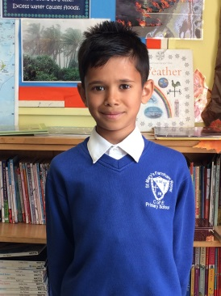
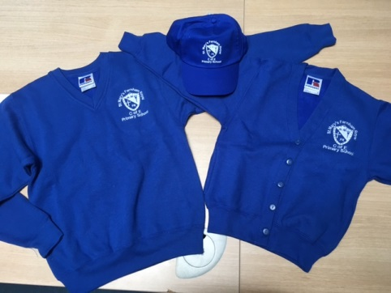
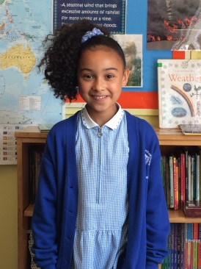
School Uniform
We are very proud of our school. Our uniform expectations reflect this and they encourage children to take pride in themselves, their school and the work they produce.
Boys:
• white shirt or polo shirt
• grey shorts or trousers
• blue v-neck sweat shirt with
school logo
• silver and royal blue striped tie
• grey or white socks
• black school shoes (preferably
with velcro) — no trainers or boots
Girls:
• white blouse or polo shirt
• grey skirt, pinafore dress or trousers
• blue v-neck sweat shirt with school logo, or
cardigan with the school logo
• silver and royal blue striped tie
• grey or white socks or tights
• black flat heeled school shoes (preferably
with velcro) — no trainers or boots
•in summer, a blue and white striped
or gingham dress
St Mary’s Farnham Royal Church of England Primary School
‘is a GOOD school’ – Ofsted Summer 2019

Slide 3
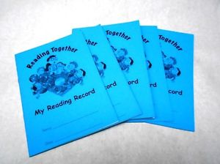

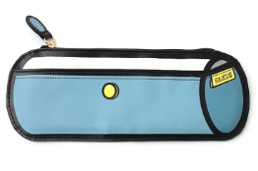

Daily Equipment needed
Looking after personal equipment encourages children to become responsible for their possessions and take care of and prepare the things they need each day for school.
Key Stage 2
Water Bottle – this needs to be regularly cleaned at home
Reading Record
Reading Book
Pencil case – pencils, pens (if obtain pen license) and coloured pencils. Name items if possible
Weekly – Homework / Spelling
Key Stage 1
Water Bottle – this needs to be regularly cleaned at home
Reading Record and reading book to be bought in daily. Please try to read with your child every day and write this in their reading record.
Shared reading book to enjoy together and return to school on a Friday
Wellies for digging area.
St Mary’s Farnham Royal Church of England Primary School
‘is a GOOD school’ – Ofsted Summer 2019

Slide 4
P.E.
P.E. is a very important part of the curriculum as it promotes an active and healthy lifestyle.
P.E. incorporates numerous skills including gymnastics, dance, athletics and a range of different sports.
The children have two PE lessons a week.
(Tuesday’s) and (Thursday’s)
For these lessons your child will need a logo blue t-shirt, blue or black shorts and a pair of suitable trainers
When the weather begins to get cold you will also need to provide them with dark tracksuit bottoms and a jumper to keep them warm during outdoor sessions.
Year 5 & 6 children only need an additional kit for football at lunch time. This does not need to be a school kit
St Mary’s Farnham Royal Church of England Primary School
‘is a GOOD school’ – Ofsted Summer 2019

Slide 5
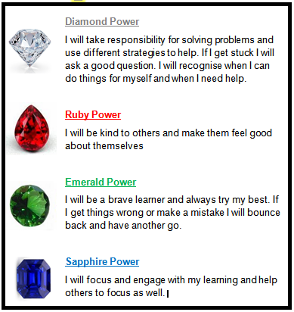
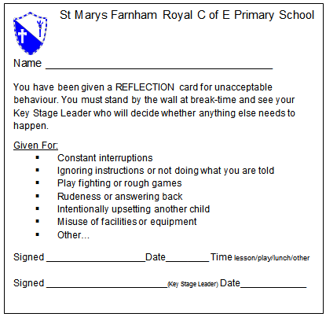
Behaviour System
We use the Gem Project to reward positive behaviour and learning attitudes.
Children receive Gem cards and one child per class receives the weekly Gem certificate in Whole School Collective Worship.
Failure to follow school rules results in a reflection card.
St Mary’s Farnham Royal Church of England Primary School
‘is a GOOD school’ – Ofsted Summer 2019

Slide 6
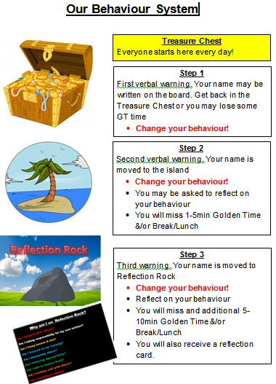
How it Works
In each classroom there is a treasure chest, island and reflection rock.
3 reflection cards per half term results in a meeting with parents to discuss ways forward with their child’s behaviour.
Sometimes children may use a behaviour chart to help them focus on their behaviour.
St Mary’s Farnham Royal Church of England Primary School
‘is a GOOD school’ – Ofsted Summer 2019

Slide 7
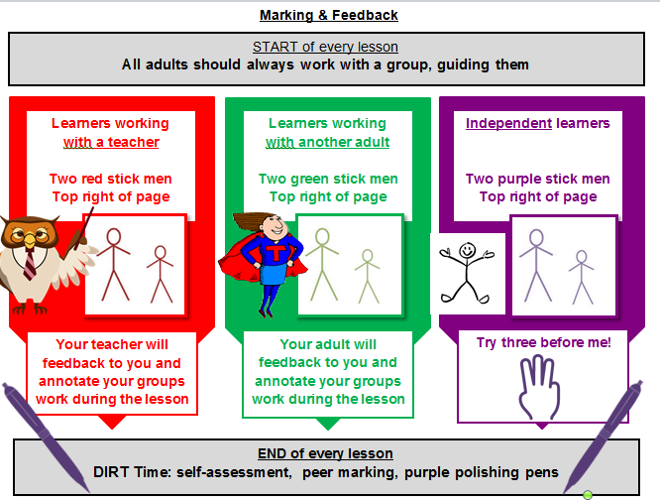
Marking Policy
As a GOOD school we must continue to improve, stay current and be innovative.
So we trailed the policy arising from the DfE review of Marking & Feedback led by Dawn Copping Headteacher @ Shaw Primary Academy – GOOD school
St Mary’s Farnham Royal Church of England Primary School
‘is a GOOD school’ – Ofsted Summer 2019

Slide 8
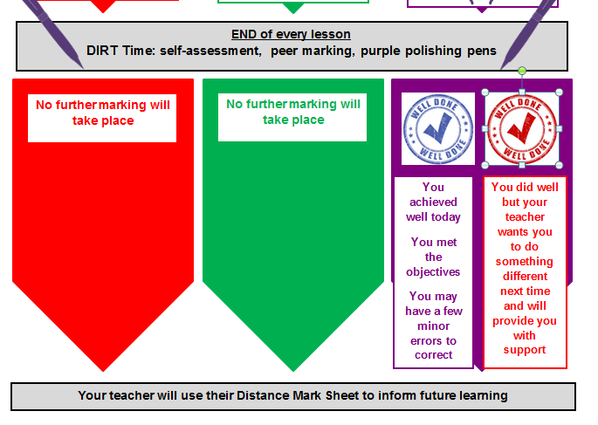
Marking Policy
By adopting this policy our main aim is to enable teachers & support staff to spend more time with the children working, verbally feeding back, discussing, debating and doing what they do best – teaching!
St Mary’s Farnham Royal Church of England Primary School
‘is a GOOD school’ – Ofsted Summer 2019

Slide 9

How can you help? - Attendance
Make sure your child is in school! Attendance is crucial missing 1 day can mean they miss one crucial lesson/skill that leads in to the next day/week.
If your child misses as school they may develop gaps in their learning which can result in lower achievement & progress, especially under the new curriculum which is more focused on breadth, depth & understanding.
Following Ofsted Summer 2019 this is a whole school focus
You child should only miss school if:
They are too ill to attend
You have advance permission from the school as it is an exceptional circumstance
St Mary’s Farnham Royal Church of England Primary School
‘is a GOOD school’ – Ofsted Summer 2019

Slide 10
How Can you help? - Homework
With the New curriculum there is now a much greater emphasis on children undertaking homework.
What are the benefits?
To encourage both independent learning and discussion / research with members of the family in order to engage both the child and others in the home.
It consolidates and reinforces skills in maths reasoning, writing and reading.
Homework should be an enjoyable learning activity!
Give them time to practice. It is no longer about just moving children on as quickly a possible to the highest level. It is now about breadth, depth and understanding too.
St Mary’s Farnham Royal Church of England Primary School
‘is a GOOD school’ – Ofsted Summer 2019

Slide 11
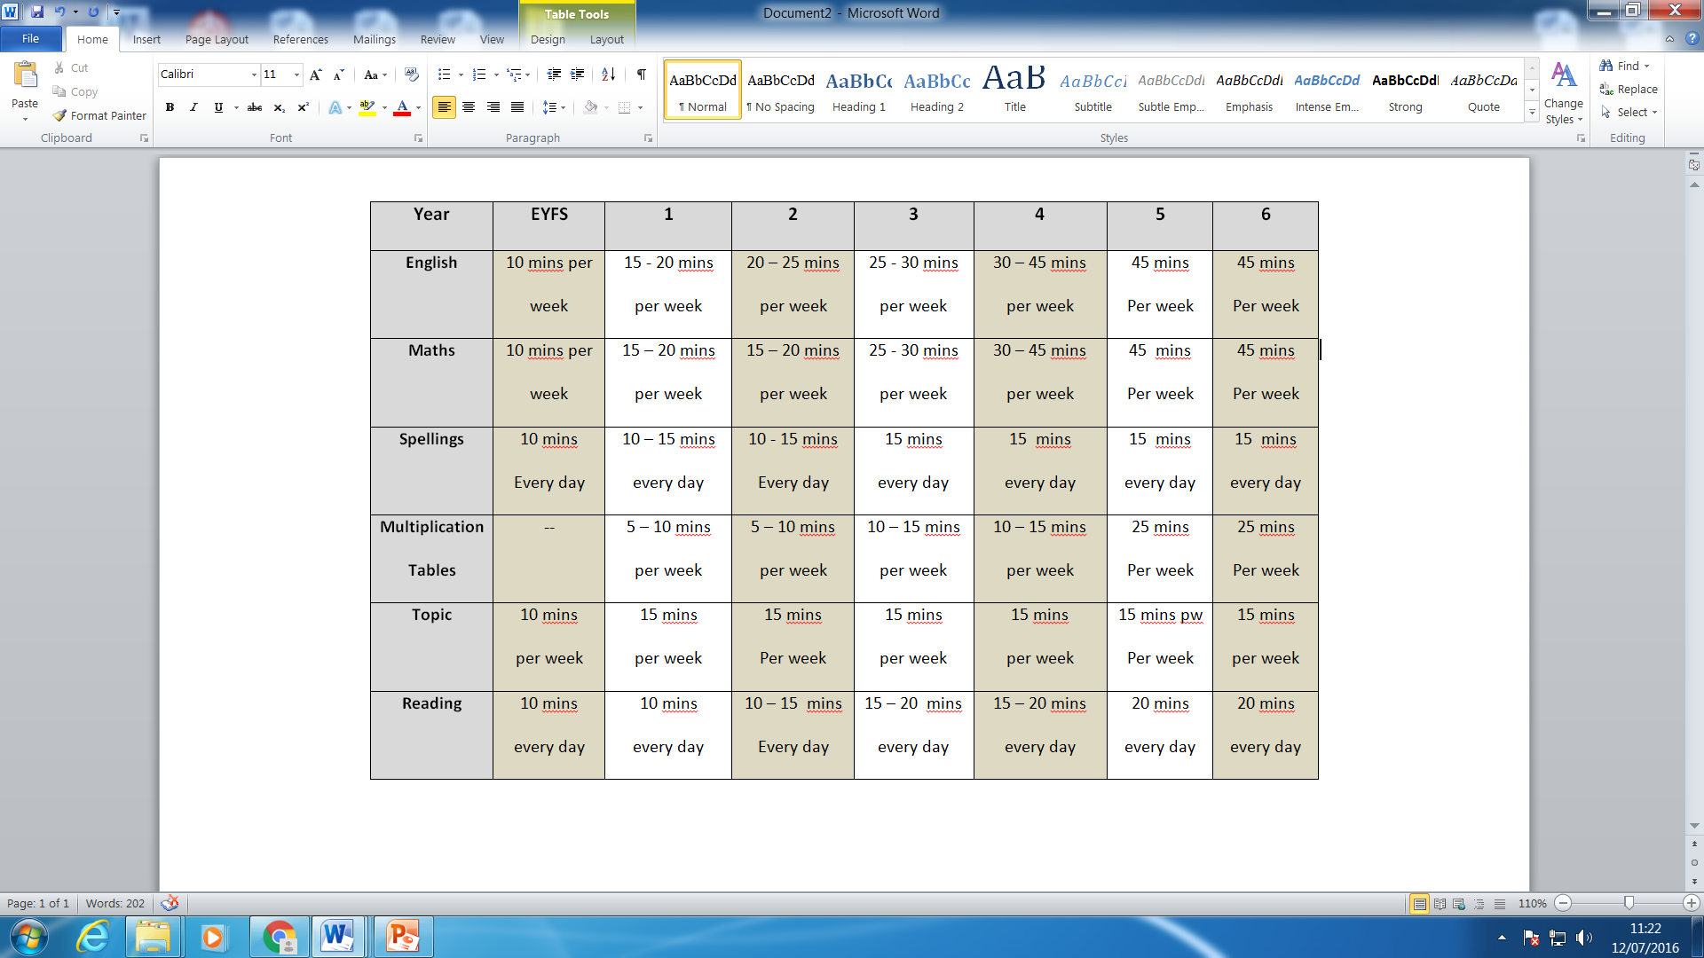
Homework at St Mary’s
Please remember that this is a guide to how long your child should be taking on their homework both weekly and daily
St Mary’s Farnham Royal Church of England Primary School
‘is a GOOD school’ – Ofsted Summer 2019

Slide 12
Topics in Year 1
 | Topics | Science | Our Trip
Autumn | Childhood Our Wonderful World | Everyday Materials Human Senses | TBC
Spring | Bright lights, Big City | Seasonal Changes Plant Parts | TBC
Summer | School Days | Animal parts | TBC
St Mary’s Farnham Royal Church of England Primary School
‘is a GOOD school’ – Ofsted Summer 2019

Slide 13
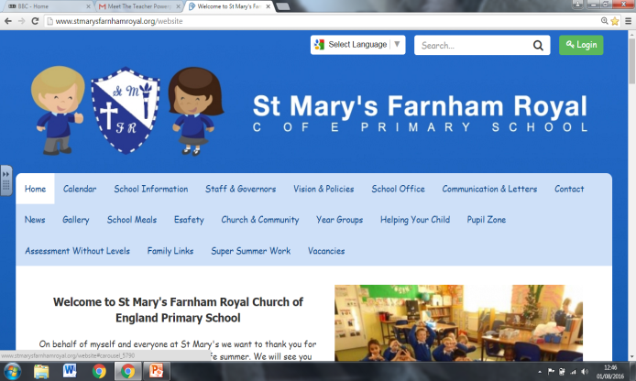
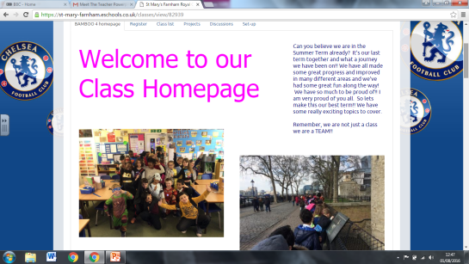
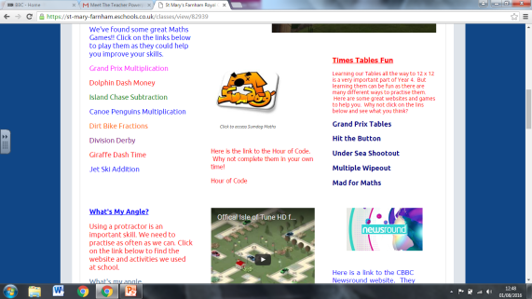
School Website and Class Webpage
Our School website is the place to access up to date information about all things happening at school.
There are also really useful sections to help support all the learning that happens at school:
Helping Your Child
Pupil Zone
stmarysfarnhamroyal.org
Each class has their own secure Webpage created and updated by the class teachers. This is accessed by an individual login.
Children are encouraged to use this area to promote their learning through blogging, use targeted activities and links identified by teachers to support the learning in class and to safely message and chat to other members of their class.
St Mary’s Farnham Royal Church of England Primary School
‘is a GOOD school’ – Ofsted Summer 2019

Slide 14
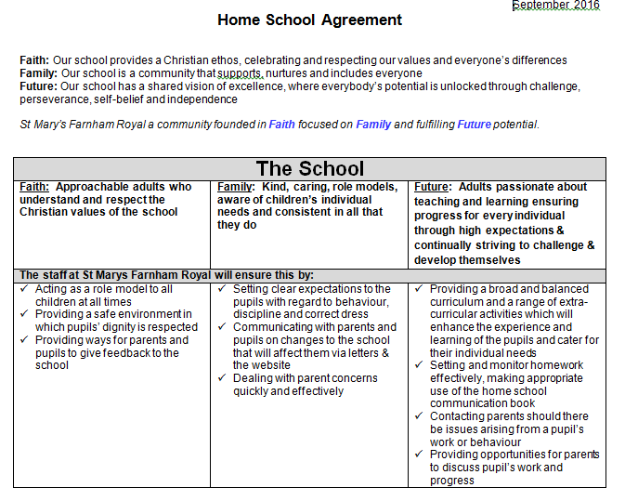
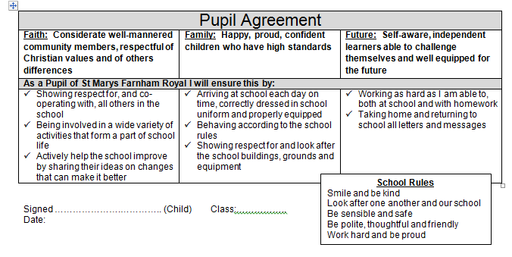
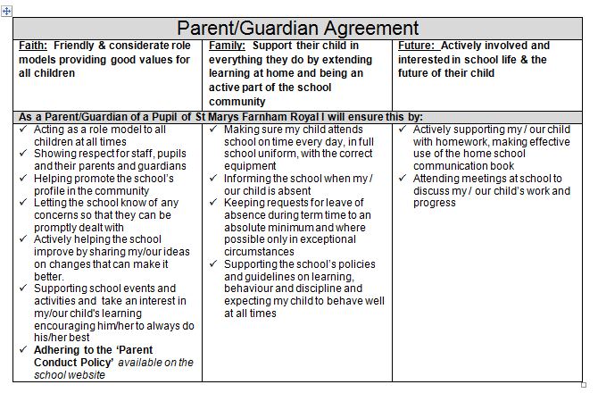
Home School Agreement
This is accessible on the school website.
You do not need to return as this is a school policy that all homes must adhere to.
Main foci:
School: Approachable adults with clear & consistent expectations
Children: Work hard and follow the school rules
Parents/Guardians: Act as role models at all times and support the school
St Mary’s Farnham Royal Church of England Primary School
‘is a GOOD school’ – Ofsted Summer 2019

Slide 15
Home times
Parents from all year groups should make sure the office have an up to date list of who has permission to collect their child
Children must be collected from the teacher at 3.15 .
Year 5 & 6 are the only children able to leave the school site alone at home time
This is only with written permission from you
St Mary’s Farnham Royal Church of England Primary School
‘is a GOOD school’ – Ofsted Summer 2019

Slide 16

Communication
Daily messages
Teachers at home time
School Office Tel: 01753644471
Office@stmarysfarnhamroyal.org
Whilst there are two members of SMT on the gate each morning there priority is the safe entry of the children and they may not be able to speak at length
Staff by appointment via the school office
Website – up to date calendar
ESchools APP
School sends info, reminders & notices
Log in via eschools
If you do not have the APP then emails will be sent to your email address
Paper Letters
Only if permission is required
Facebook/Instagram
Follow: St Mary's Farnham Royal Primary School
(Not all message's go onto this public forum)
St Mary’s Farnham Royal Church of England Primary School
‘is a GOOD school’ – Ofsted Summer 2019

Slide 17
Any Questions?
Presentations will be made available on the school website
wwww.stmarysfarnnhamroyal.org
Important school dates for the year ahead are available
St Mary’s Farnham Royal Church of England Primary School
‘is a GOOD school’ – Ofsted Summer 2019

