Slide 1
Welcome to the EYFS
at
St Mary’s Farnham Royal
Through FAITH, as a FAMILY we aspire to grow. Thriving for all our FUTURES, enabling us to FLOURISH individually and as a community.
St Mary’s Farnham Royal Church of England Primary School
‘is a GOOD school’ – Ofsted November 2019

Slide 2
Welcome to our school
Your EYFS team:
Nursery Learning Support:
Mrs G. Moore and Miss K. Read
Reception Class Teachers:
Mrs C. Connolly (Mon, Tues & Thurs)
Ms D. Bachmann (Wed & Fri)
Reception Learning Support:
Miss J. Shrimpton
St Mary’s Farnham Royal Church of England Primary School
‘is a GOOD school’ – Ofsted November 2019

Slide 3
Welcome to our school
Key Members of staff in our school:
Mr S. Broderick – Headteacher
Mr J. Farmer – Deputy headteacher
Ms D.Bachmann – Assistant Headteacher
Miss L. Bailey – Assistant Headteacher
Miss K. Lewis - School Office & Admissions
St Mary’s Farnham Royal Church of England Primary School
‘is a GOOD school’ – Ofsted November 2019

Slide 4
Transition Meeting overview
Meet the Team
Uniform
What does my child need to bring
Lunches
Behaviour system
Our Curriculum
Tapestry
Attendance
Communication
Pastoral Support
St Mary’s Farnham Royal Church of England Primary School
‘is a GOOD school’ – Ofsted November 2019

Slide 5
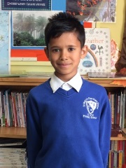
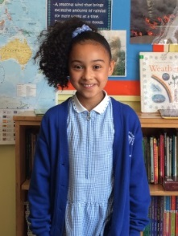
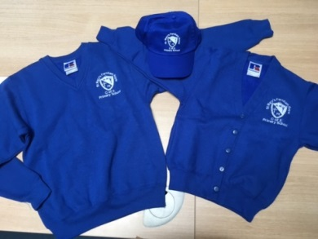
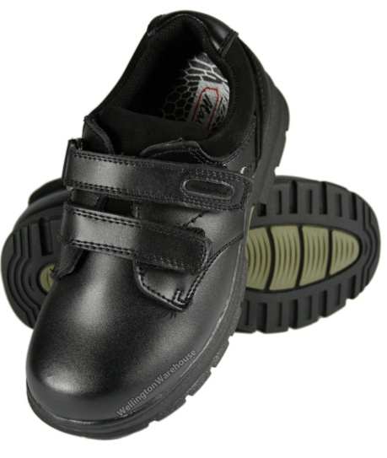
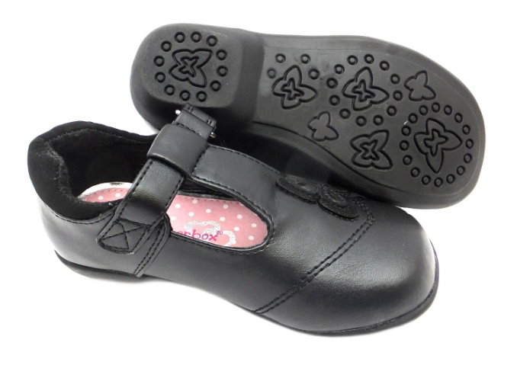
School Uniform
White shirt, blouse or polo shirt
Grey/black shorts, trousers, skirt or dress
Royal blue sweatshirt/cardigan, with or without school logo
Grey/white/black socks or tights
Black school shoes or black trainers (preferably with velcro) (No heels)
School cap
Blue and white gingham dress
Please ensure everything is clearly named.
St Mary’s Farnham Royal Church of England Primary School
‘is a GOOD school’ – Ofsted November 2019

Slide 6
PE Kit – To wear to school on PE Day
School PE Shirt
Black/Navy shorts
Trainers
Black/Navy jogging bottoms for colder weather
Royal blue v-neck sweatshirt, with or without school logo
No Jewellery – Micropore tape for studded earrings
Sweatbands to cover religious bangles
Hair
Hair styles should be appropriate for school
Shoulder length hair must be tied back
Hair accessories with flowers, large bows etc are not part of school uniform Jewellery
Jewellery must not be worn. However, if your child has pierced ears, small plain stud earrings may be worn. These will be taped over during PE.
Nail varnish should not be worn in school.
St Mary’s Farnham Royal Church of England Primary School
‘is a GOOD school’ – Ofsted November 2019

Slide 7
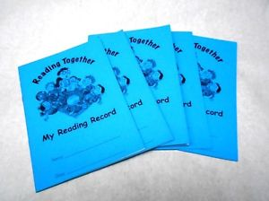
What your child needs to bring to school
Water bottle- with water only please
Waterproof coat and wellies
Change of clothes- to stay in school
Book bag - no rucksacks please!
Reading book and reading record
Please ensure everything is clearly named.
St Mary’s Farnham Royal Church of England Primary School
‘is a GOOD school’ – Ofsted November 2019

Slide 8
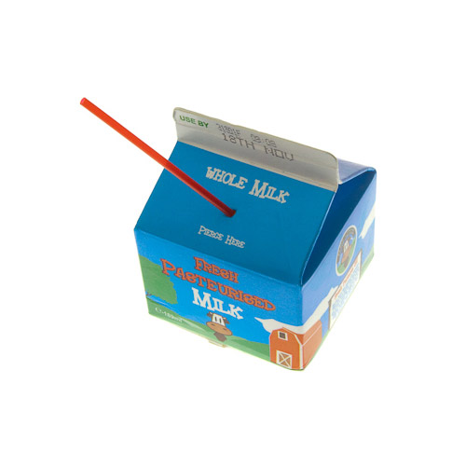
Fruit and Milk Time
Milk is free up to the age of 5 and can be ordered online via ‘Cool Milk’.
Children can choose from various fruits for their snack, at no cost.
If your child would like to bring in some fruit (in a named pot) you are welcome to.
Please ensure the office are aware of any dietary requirements PRIOR to your child starting with us.
St Mary’s Farnham Royal Church of England Primary School
‘is a GOOD school’ – Ofsted November 2019

Slide 9
Hot Lunches
Children in Reception to Year 2 are entitled to a Universal Free school meal each day.
Menus change termly and are a five week rolling menu.
Each term, the website is updated with the new menu. Please choose carefully with your child, so they know what to expect!
Nursery children who join us for lunch are welcome to have a hot school dinner. Parents will be charged via their online account. Otherwise, they will need a healthy packed lunch.
Please ensure the office are aware of any dietary requirements PRIOR to your child starting with us.
St Mary’s Farnham Royal Church of England Primary School
‘is a GOOD school’ – Ofsted November 2019

Slide 10
Packed Lunches
All Nursery and Reception children are welcome to bring a healthy packed lunch if they would prefer.
Packed Lunches should be healthy:
No foods containing nuts are allowed in school (including chocolate spread & peanut butter)
No chocolate, other than biscuit based chocolate snacks
No sweets or high sugar foods
All children should have a packed lunch drink as well as a water bottle.
There are some great healthy lunchbox ideas on https://www.nhs.uk/healthier-families/recipes/healthier-lunchboxes/
Please ensure the office are aware of any dietary requirements PRIOR to your child starting with us.
St Mary’s Farnham Royal Church of England Primary School
‘is a GOOD school’ – Ofsted November 2019

Slide 11
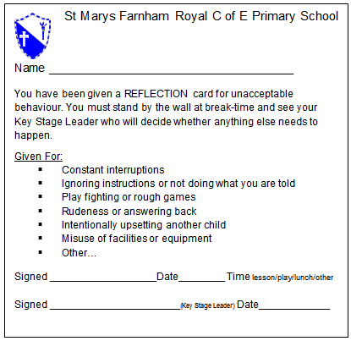
Behaviour System
We use the Gem Project to reward positive behaviour and learning attitudes. And lots of stickers too ☺
In EYFS we use ‘Time Out’ (when your child is removed from where misbehavior happened) to help change any negative behaviours and support positive ones!
St Mary’s Farnham Royal Church of England Primary School
‘is a GOOD school’ – Ofsted November 2019

Slide 12
Our Curriculum
The Early Years Foundation Stage Framework is a statutory guidance that your child may have learnt from at their previous settings. Within the EYFS, we also use the Characteristics of Effective Teaching and Learning.
These are based on how each child learns and skills they need to ensure a good attitude to learning throughout their school life.
The EYFS covers 3 prime areas:
Communication and Language
Personal Social and Emotional Development
Physical Development
and 4 specific areas:
Literacy
Mathematics
Understanding the World
Expressive Art and Design.
The Characteristics of Effective Learning are:
Playing and Exploring
Active Learning
Creating and thinking critically
St Mary’s Farnham Royal Church of England Primary School
‘is a GOOD school’ – Ofsted November 2019

Slide 13
Our Curriculum
From this September, SMFR are looking forward to delivering the Cornerstones Curriculum. This is an in depth curriculum that ensures greater understanding of concepts and topics. Cornerstones monitors child’s progress to identify those who may need some additional support in some areas.
Cornerstones ensures parents are a key part in their child’s learning. You will be provided with an overview at the start of each term. Throughout the year, there will be parents evenings and reports so you are aware of how your child is getting on.
At the end of their Reception year, children will be assessed against the Early Learning Goals. The ELGs are set at the development of a typical five year old.
Children are given emerging or expected against each of the 17 areas within the prime and specific areas.
More information on the Early Years Foundation Stage can be found at
https://www.gov.uk/government/publications/early-years-foundation-stage-framework--2
St Mary’s Farnham Royal Church of England Primary School
‘is a GOOD school’ – Ofsted November 2019

Slide 14
Tapestry
Tapestry is a secure, online learning portal used in our school to share WOW moments between school and home (and vice versa!)
At the start of the year, you will receive a link to create a log in. Please follow the instructions on the link to create your account. From there you can see any observations we make of the children, upload your own ‘WOW’ moments, view notifications and upload home learning.
St Mary’s Farnham Royal Church of England Primary School
‘is a GOOD school’ – Ofsted November 2019

Slide 15
How can you help? - Attendance
If your child regularly misses school they may develop gaps in their learning which can result in lower achievement & progress.
Your child should only miss school if:
They are too ill to attend – some useful information sheets are available.
You have advance permission from the school as it is an exceptional circumstance
We monitor the attendance for all children in our school. Nursery children’s attendance is also monitored as per the Parental Agreement and your Nursery child’s place may be withdrawn if attendance rules are not adhered to.
Please always call the school to let us know why your child is not attending.
St Mary’s Farnham Royal Church of England Primary School
‘is a GOOD school’ – Ofsted November 2019

Slide 16
The School Day
We ask parents to be punctual at drop off and collection.
8:30 am Drop off
8:50am School day begins
9.00 am Register and welcome
9.15 am Phonics session
9.45 am Milk and fruit
10am Focus and child initiated activities
11.30am Nursery AM home time. Shared Reading
12.30pm Lunchtime
1.30 pm Focus and child initiated activities
2.45 pm Collective Worship, Music, Storytime
3.10 pm Home time
St Mary’s Farnham Royal Church of England Primary School
‘is a GOOD school’ – Ofsted November 2019

Slide 17
Treetops Before and Afterschool Care
Breakfast Club is available from 7.30am - 8.30am
£5 for the hour, which includes breakfast.
Alternatively, your child can join us from 8.00am - 8.30am
£2.50. Breakfast not included.
After School Club runs from 3.30pm-5.30pm, 1.5hrs
£5 per hour, snack is included.
St Mary’s Farnham Royal Church of England Primary School
‘is a GOOD school’ – Ofsted November 2019

Slide 18
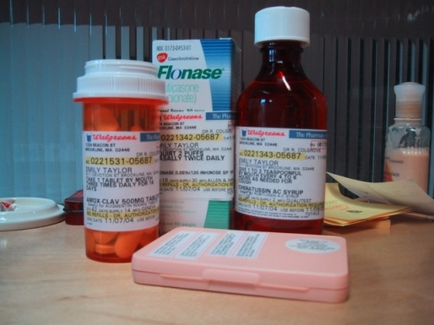
Important things to remember!
Please keep the school office up to date
with emergency
contact numbers
Only prescribed medicines
from doctor
Medication form
Please ensure child collection list is up to date
St Mary’s Farnham Royal Church of England Primary School
‘is a GOOD school’ – Ofsted November 2019

Slide 19
Communication
We love to talk! ☺ We have an open door policy, so please feel free to stop and speak to one of us at the door in the morning or in the afternoon. At times, we may have to ask you to wait for a few moments but we will always be willing to speak to you.
Other forms of communication:
Email- either via the office or direct to the teachers.
Telephone- please call the school office. We may not be able to ring you back straight away but we will endeavour to do so the same day.
You can keep up to date with information and what's happening at school through:
Tapestry
Website
Posters
Letters/Newsletters
Instagram- stmarysfr1
St Mary’s Farnham Royal Church of England Primary School
‘is a GOOD school’ – Ofsted November 2019

Slide 20
Pupil Premium Funding
Your child may be entitled to Pupil Premium Funding which will support their education. Applications are completely confidential.
How do I know if I am eligible?
Please fill out a form if you are experiencing any difficulties financially as you may be eligible.
The funding can help with trips, clubs, uniform and interventions in school.
Funding stays with your child until they leave primary school.
St Mary’s Farnham Royal Church of England Primary School
‘is a GOOD school’ – Ofsted November 2019

Slide 21
Pastoral Support
Mr Farmer is our Pastoral Support Leader & can support children & families by request or by the schools own identification of needs:
Safeguarding
Homework
Behaviour
Attendance
Reducing barriers to learning
Children's Well Being
St Mary’s Farnham Royal Church of England Primary School
‘is a GOOD school’ – Ofsted November 2019

Slide 22
In September…
Tuesday 5th – Home Visits - to answer any questions, check forms etc.
Wednesday 6th - Phonecall – to answer any questions, check forms etc.
Please sign up to a slot today!
Thursday 7th – Children in to school 8:50am – 3:10pm
St Mary’s Farnham Royal Church of England Primary School
‘is a GOOD school’ – Ofsted November 2019

Slide 23
Any Questions?
Please feel free to contact the school office who will pass on your message to a member of the team.
office@smfr.co.uk
We can’t wait to have you join us in September!
☺
St Mary’s Farnham Royal Church of England Primary School
‘is a GOOD school’ – Ofsted November 2019

