Slide 1
School Nursing Team

Slide 2
Who are we?
Specialist Community Public Health Nurse (SCPHN)
Community Staff Nurse
Community Nursery Nurse
School Health Assistant
Responsibility changes from the ‘Health Visiting Team’ to the ‘School Nursing Team’ when children start school
Our service covers young people
until they are 19yrs, if they are in
full time education (whether at
School, college or home educated)
Notes:
SCPHN – usually referred to as the ‘School Nurse’.
We are different from the school matrons who are based within a school.
We are a team of nurses based in the community and are responsible for all the schools in our area – both primary & secondary.

Slide 3
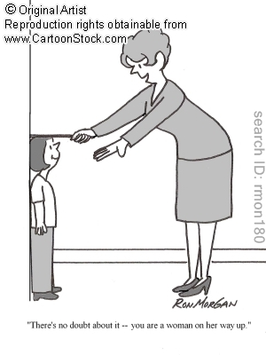
National Child Measurement Programme (NCMP)
You will receive a letter regarding this
Height
Weight
and
It will be done within the first year of being at school, and then repeated in Year 6
Notes:
The National Child Measurement Programme (NCMP) measures the weight and height of children in Reception class and Year 6.
This data can be used at a national level to support public health initiatives but also helps your local NHS to plan and provide better health services for the children in your area.
Every child measured is contributing to the national picture about how children are growing, therefore, the more children who participate, the clearer that picture will be.
Today, one in three children in the UK aged between 2 and 10 years is overweight.
Research shows that if your child is overweight now, they are more likely to grow up to be overweight as an adult. This can lead to health problems in later life, so this measurement is an important way of checking how your child is growing.
Parents will automatically be sent their child’s results in the post and depending on the results may receive a follow-up phone call from one of the team.
Show pack (NCMP letter; results letter with change for life info etc)

Slide 4
Vision Testing
Will be done within the first year of being at school.
Please inform the school nursing service if your child is currently under professional care.
You can have your child’s vision tested
anytime at a local optician..….and it’s free!
Hearing Test
This is no longer routinely carried out in school.
If you have any concerns regarding your child’s hearing, we can organise a hearing test
Notes:
It’s best to register with a local optician so that your child’s eyes are checked regularly, as a child’s vision can change as they grow.
Optometrists - specialise in giving glasses for long or short-sightedness.
Opticians - help choose glasses frames and fit glasses.
Orthoptists - investigate children’s vision, diagnose and treat binocular vision defects (vision involving the use of both eyes) and eye movement abnormalities.
Ophthalmologists - diagnose and treat eye conditions, if necessary, using medication or surgery.

Slide 5
Health Screening
Parents will be asked to fill in an electronic
Health Questionnaire
The Questionnaire is a way that:
we can identify areas of need, and work with schools to deliver targeted intervention
you can highlight any existing medical needs or conditions to us
We are notified if any child or family require further support following A&E attendance
we can offer you advice, or signpost you to other agencies
All information concerning your child is confidential
Notes:
If you don’t have internet – please contact us as we can provide a paper copy

Slide 6
Notes:
This is the website you will be given to log into
You will have your own individual login details.
The health questionnaire is on a secure website
School Nurse will analyse the data and identify any areas of need, with individuals and within schools.
We will contact you to discuss any issues or concerns you have raised.
We can work with schools to deliver targeted intervention ie. Handwashing/hygiene, or we can involve local services ie. bereavement etc.
There will be 2 other health questionnaires in Year 6, and Year 9 , which your child will complete in school.

Slide 7
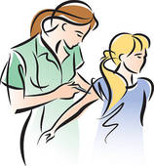
Vaccinations
Please check that your child's vaccinations are up-to-date
By school entry they should have received:
Four doses of diphtheria, tetanus, pertussis and polio.
Two doses of MMR vaccine.
A single dose of Hib/MenC conjugate.
Flu nasal spray is given to children in Reception and Years 1, 2, 3 and 4 in school – consent is required.
The Red Book is still a useful resource for storing all your child’s health information
Notes:
Children should have had their pre-school boosters DTP & MMR - check with their GP if unsure
Won’t need any more vaccinations until they reach secondary school.
‘Vaccination’ and ‘immunisation’ are often used interchangeably but their meanings are not exactly the same.
Vaccination - is when an ‘inactivated’ vaccine is administered to you (usually by injection).
Immunisation - is what happens in your body after you have the vaccination. The vaccine stimulates your immune system so that it can recognise the disease and protect you from future infection (i.e. you become immune to the infection).
Inoculation – is when a ‘live’ vaccine is administered
The BCG vaccine (Bacillus Calmette-Guérin vaccine) protects against TB.
It's not given as part of the routine NHS childhood vaccination schedule unless a baby is thought to have an increased risk of coming into contact with TB.
Routine BCGs for school-aged children were stopped in Sept 2005
BCG vaccination may be recommended for older children who have an increased risk of developing TB, such as:
children who have recently arrived from countries with high levels of TB
children who have come into close contact with somebody infected with respiratory TB
Facts
BCG vaccination is rarely given to anyone over the age of 16 and never over the age of 35, because it doesn't work very well in adults.
TB is a difficult disease to catch because it requires prolonged exposure to an infected person. For example, you are very unlikely to catch it by sitting or standing next to someone who is infected.
Rates of TB in the UK population have fallen to very low levels over the past 15 years.
The BCG vaccination programme was changed to reflect this and is now only given to people in at-risk groups.

Slide 8
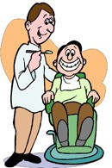
Dentist
Your child should:
have 6 monthly check up’s
be registered with a dentist before they start school
be using adult toothpaste
A list of NHS dentists can be found on the ‘NHS Choices’ website.
NHS dental treatment is free for children
Notes:
You do not have to pay for NHS dental treatment if, when your treatment starts, you are:
under 18
under 19 and in full-time education
Dental advice for children
Fluoride is a naturally occurring mineral added to the drinking water and many brands of toothpaste as a preventive measure against tooth decay. It's also found in certain foods, including tea and fish.
Children up to three years of age should use toothpaste with a fluoride level of at least 1,000ppm (parts per million).
After three years of age, children should use toothpaste with a fluoride level of 1,350-1,500ppm. The level of fluoride can be found on the pack.
Children should be supervised when brushing their teeth until about seven years of age.
The amount of toothpaste your child uses is important. Up to the age of three, a smear of toothpaste is sufficient, and from age three a pea-sized amount is recommended.
Encourage your child to spit the toothpaste out after brushing their teeth rather than swallowing it.
NHS Choices

Slide 9
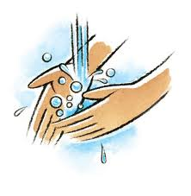
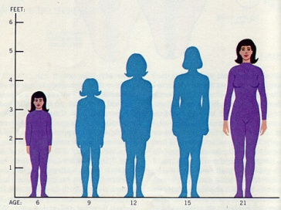
Health Promotion
We offer Health Promotion sessions such as:
Hygiene :
handwashing
dental care
Healthy living:
healthy eating
alcohol
safe medicines/drugs
smoking
Sweets or medicines
Puberty/Sexual Health
This is done:
according to need
in line with the National Curriculum
being age appropriate (Primary & Secondary School)
Notes:
This may be requested by schools or targeted from the Health Questionnaire.

Slide 10
Emotional Support
We offer one-to-one sessions
Referrals can be made via:
school
phoning us directly
highlighting it on the on-line questionnaire

Slide 11
Healthy Child
Recommended physical activity:
Children under 5yrs: 180 minutes/day
Young people (5 – 18yrs): 60 minutes/day
Notes:
Change 4 life website – very informative.

Slide 12
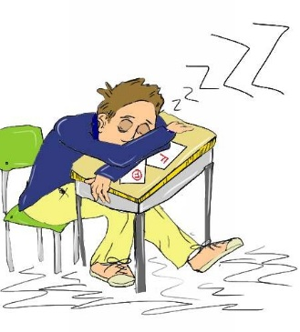
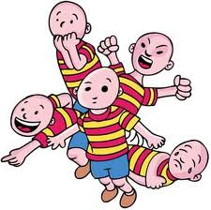
Sleep
Sleep is just as important for children’s development as healthy eating and exercise
Using computers, mobiles and TVs at night can affect children's sleep and therefore impact on their health, mood and performance at school
Lack of sleep can:
affect a child’s performance the following day
cause a child to become irritable, overactive, lack concentration and have extremes of behaviour
Notes:
The brain is undergoing major ‘restructuring’ and ‘rewiring’ and sleep is important for it to recover.
It is important to have a good bedtime routine, where children can ‘wind down’ and relax before going to bed.
Limit the use of TVs, mobile phones or computers during the evening
There's no magical number of hours of sleep that all children in a particular age group need. Millpond Children’s Sleep Clinic recommend:
1 week - daytime: 8 hours / night time: 8.5 hours
4 weeks – daytime: 6.75 hours / night time: 8.75 hours
3 months - daytime: 5 hours / night time: 10 hours
6 months - daytime: 4 hours / night time: 10 hours
9 months - daytime: 2.75 hours /night time: 11.25 hours
12 months - daytime: 2.5 hours / night time: 11.5 hours
2 years - daytime: 1.25 hours / night time: 11.75 hours
3 years - daytime: 1 hour / night time: 11 hours
4 years - 11.5 hours
5 years - 11 hours
6 years - 10.75 hours
7 years - 10.5 hours
8 years - 10.25 hours
9 years - 10 hours
10 years - 9.75 hours
11 years - 9.5 hours
12 years - 9.25 hours
13 years - 9.25 hours
14 years - 9 hours
15 years - 8.75 hours
16 years - 8.5 hours

Slide 13
Bedwetting (Enuresis)
20% of children will still wet the bed at the age of 5
We can provide information on general strategies for children under 7
If your child is still wetting the bed at 6½yrs, please visit your GP for a referral to the School Nurse led enuresis clinic
For more information please visit:
http://www.eric.org.uk/

Slide 14
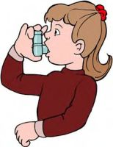
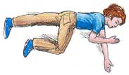
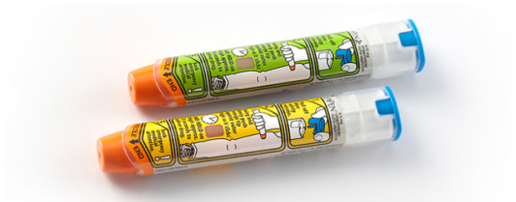
Staff Awareness
We offer sessions to school staff on medical conditions, to raise awareness and ensure regular updates:
asthma
epilepsy
anaphylaxis
You can highlight any medical conditions or significant health needs on the on-line questionnaire
We can work with you and school to develop a Health Care Plan
Notes:
You can indicate this on the Health Questionnaire.

Slide 15
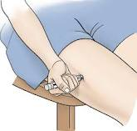
Medication in school
There should be no non-prescribed medicines in school
Schools have a policy for managing medicines in school
You will need to fill out the appropriate
forms so that your child can receive
their medication
Notes:
It is the parents responsibility to check expiry dates and keep the school updated with any changes to the health care plan.

Slide 16
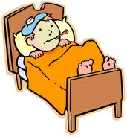
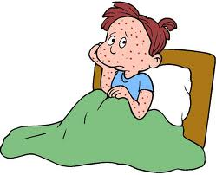
Illnesses
Diarrhoea & vomiting Your child should be off school for 48hrs from the last episode
Threadworm
Prescriptions can be obtained from the GP/chemist
Chickenpox
Is infectious from 1 - 2 days before the rash starts, until all the blisters have crusted over
School has information about exclusion
times for various illnesses – if you are
unsure please ask
Notes:
Chickenpox (medically known as varicella) is caused by a virus called the varicella-zoster virus. It's spread quickly and easily through the coughs and sneezes of someone who is infected.
Chickenpox is most infectious from one to two days before the rash starts, until all the blisters have crusted over (usually five to six days after the start of the rash).
A threadworm infection is usually passed from person to person as a result of poor personal hygiene.
A female threadworm can lay thousands of tiny eggs around the anus or vagina. While laying eggs, the female threadworm also releases a mucus that causes itching.
Scratching the anus or vagina, or wiping them after going to the toilet, can result in the eggs becoming stuck on your fingertips or under your fingernails.

Slide 17
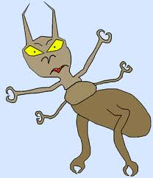
Head Lice
Treatment
Long hair should be tied up at school
Check your child’s hair regularly by wet combing with a special fine-toothed comb (with a spacing of less than 0.3mm)
Wet combing / medicated lotions
Check the whole family
Facts
Spread rapidly by prolonged head contact
Walk from head to head (do not have wings)
Grow to about the size of a sesame seed
Scalp may not start itching for a few days
Notes:
Head lice are tiny wingless insects that live in human hair.
Head lice are grey-brown in colour, the size of a pinhead when hatched and of a sesame seed when fully grown.
They cannot fly, jump or swim and are spread by head-to-head contact, climbing from the hair of an infected person to the hair of someone else.
A head lice infestation is not the result of dirty hair or poor hygiene. Head lice can affect all types of hair, irrespective of its condition and length.
Head lice only affect humans and cannot be passed on to animals or be caught from them
Treating head lice
Usually, head lice can be treated effectively using medicated lotions or by wet combing, using a specially designed head lice comb.
Wet combing can be used without medicated lotions, but needs to be done regularly and can take a long time to do thoroughly.
Medicated lotion or spray can be used as an alternative. However, no medicated treatment is 100% effective. Your pharmacist will be able to recommend an over-the-counter lotion or spray.
Preventing head lice
It's difficult to prevent a head lice infestation. Regular detection combing – such as on a weekly basis – is the best way to find new lice quickly.
Medicated lotions and sprays do not prevent head lice infestations and should only be used if a live louse has been found on yours or your child’s head.
Lice can become resistant to lotions/sprays

Slide 18
Useful numbers/websites
For more information please go to:
www.nasalspraylearning.co.uk
NHS Choices
www.nhs.uk
NHS 111
for health advice 24hrs a day
calls are free from landlines and mobiles
Buckinghamshire Family Information Service
www.bucksfamilyinfo.org
Children’s Centre
https://www.gov.uk/find-sure-start-childrens-centre
‎
Notes:
Family Information Service - The Buckinghamshire Family Information Service website is all you need to help you find local childcare, services, activities and events.

Slide 19
School Nursing Team
http://www.buckshealthcare.nhs.uk/School-nursing
For more information please visit the Bucks School Nursing website
http://www.buckshealthcare.nhs.uk/School-nursing/
Tel Number : 01753 888835
Email : buc-tr.chascphnSN@nhs.net
Notes:
You can contact us at any time for advice/support.
School also have our number

