Slide 1
Welcome to Year 3!
Key Stage 2 Leader: Miss Bailey
3C class Teacher: Mr Copete
3J class Teacher: Ms James
Year 3 Learning Support Assistants:
Mrs Treasure
St Mary’s Farnham Royal Church of England Primary School
‘is a GOOD school’ – Ofsted November 2015

Slide 2
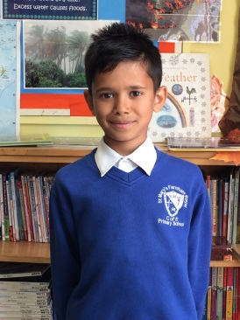
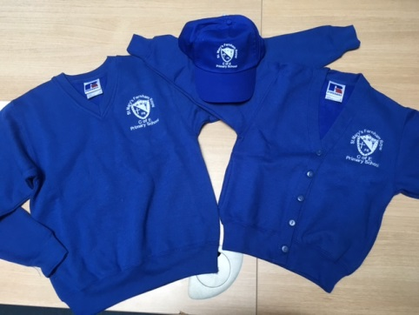
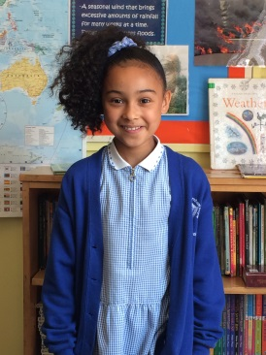
School Uniform
We are very proud of our school. Our uniform expectations reflect this and they encourage children to take pride in themselves, their school and the work they produce.
Boys: • white shirt or polo shirt • grey shorts or trousers • blue v-neck sweat shirt with
school logo • silver and royal blue striped tie • grey or white socks • black school shoes (preferably
with velcro) — no trainers or boots
Girls: • white blouse or polo shirt • grey skirt, pinafore dress or trousers • blue v-neck sweat shirt with school logo, or
cardigan with the school logo • silver and royal blue striped tie • grey or white socks or tights • black flat heeled school shoes (preferably
with velcro) — no trainers or boots •in summer, a blue and white striped
or gingham dress
St Mary’s Farnham Royal Church of England Primary School
‘is a GOOD school’ – Ofsted November 2015

Slide 3
Daily Equipment needed
Looking after personal equipment encourages children to become responsible for their possessions and take care of the things they will need each day for school.
Key Stage 2
Water Bottle – this needs to be regularly cleaned at home
Reading Record
Reading Book
Weather appropriate clothing
Named clothing
St Mary’s Farnham Royal Church of England Primary School
‘is a GOOD school’ – Ofsted November 2015

Slide 4
P.E.
P.E. is a very important part of the curriculum as it promotes an active and healthy lifestyle.
P.E. incorporates numerous skills including gymnastics, dance, athletics and a range of different sports.
The children have two PE lessons a week.
Tuesday and Wednesday
For these lessons your child will need a blue SMFR P.E top, black shorts and a pair of suitable trainers
When the weather begins to get cold you will also need to provide them with black tracksuit bottoms and a jumper to keep them warm during outdoor sessions.
Swimming will happen and when this is in place children must have:
Trunks/ one piece swimming costumes or Bermuda style shorts
A swimming cap
A towel
St Mary’s Farnham Royal Church of England Primary School
‘is a GOOD school’ – Ofsted November 2015

Slide 5
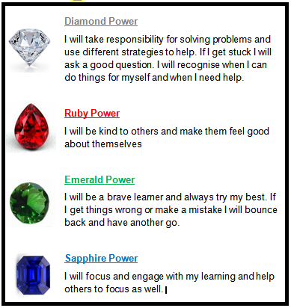
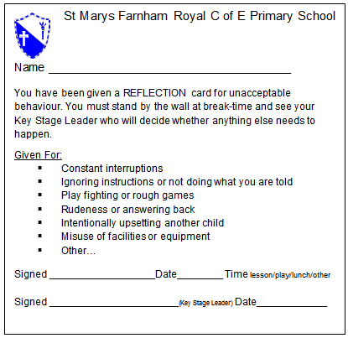
Behaviour System
We use the Gem Project to reward positive behaviour and learning attitudes.
Children receive Gem cards and one child per class receives the weekly Gem certificate in Whole School Collective Worship.
Failure to follow school rules results in a reflection card.
St Mary’s Farnham Royal Church of England Primary School
‘is a GOOD school’ – Ofsted November 2015

Slide 6
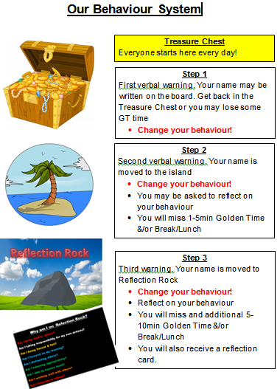
How it Works
In each classroom there is a treasure chest, island and reflection rock.
3 reflection cards per half term results in a meeting with parents to discuss ways forward with their child’s behaviour.
Sometimes children may use a behaviour chart to help them focus on their behaviour.
St Mary’s Farnham Royal Church of England Primary School
‘is a GOOD school’ – Ofsted November 2015

Slide 7
Marking Policy
As a GOOD school we must continue to improve, stay current and be innovative.
So we trailed the policy arising from the DfE review of Marking & Feedback led by Dawn Copping Headteacher @ Shaw Primary Academy – GOOD school
St Mary’s Farnham Royal Church of England Primary School
‘is a GOOD school’ – Ofsted November 2015

Slide 8
Marking Policy
By adopting this policy our main aim is to enable teachers & support staff to spend more time with the children working, verbally feeding back, discussing, debating and doing what they do best – teaching!
St Mary’s Farnham Royal Church of England Primary School
‘is a GOOD school’ – Ofsted November 2015

Slide 9
How can you help? - Attendance
Make sure your child is in school! Attendance is crucial missing 1 day can mean they miss one crucial lesson/skill that leads in to the next day/week.
If your child misses as school they may develop gaps in their learning which can result in lower achievement & progress, especially under the new curriculum which is more focused on breadth, depth & understanding.
Following Ofsted November 2015 this is a whole school focus
You child should only miss school if:
They are too ill to attend
You have advance permission from the school as it is an exceptional circumstance
St Mary’s Farnham Royal Church of England Primary School
‘is a GOOD school’ – Ofsted November 2015

Slide 10
How Can you help? - Homework
With the New curriculum there is now a much greater emphasis on children undertaking homework.
What are the benefits?
To encourage both independent learning and discussion / research with members of the family in order to engage both the child and others in the home.
It consolidates and reinforces skills in maths reasoning, writing and reading.
Homework should be an enjoyable learning activity!
Give them time to practice. It is no longer about just moving children on as quickly a possible to the highest level. It is now about breadth, depth and understanding too.
Following our recent parent/staff homework survey we have reviewed our expectations…
St Mary’s Farnham Royal Church of England Primary School
‘is a GOOD school’ – Ofsted November 2015

Slide 11
Topics in Year 3
 | Topics | Science | Our Trip
Autumn | Through the ages One planet, one world | Animal nutrition And the skeletal system | History off the page/ Chiltern open air museum
Spring | Rocks, relics and rumbles | Forces and magnets | Natural history museum
Summer | Emperors and Empires | Plants Light and shadows | TBC
St Mary’s Farnham Royal Church of England Primary School
‘is a GOOD school’ – Ofsted November 2015

Slide 12
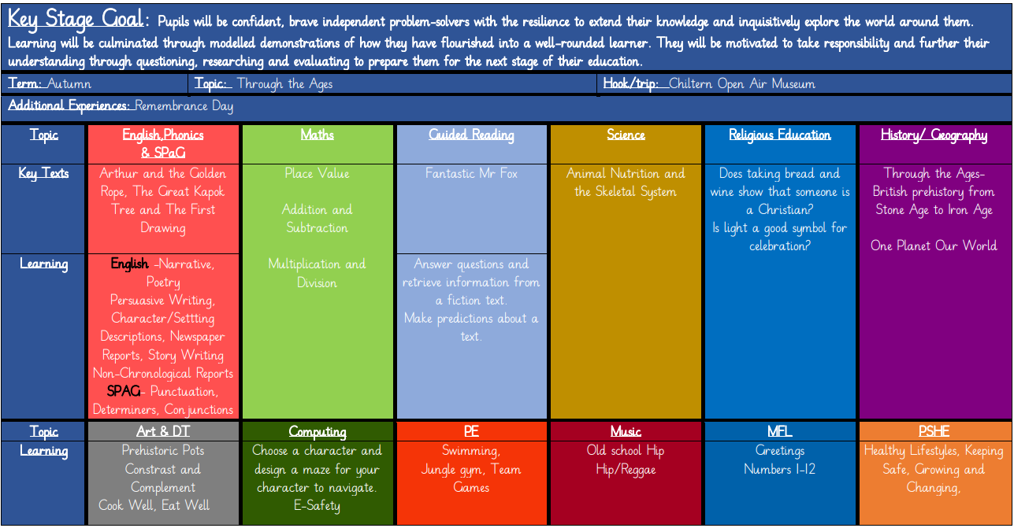
Topics in Year 3
St Mary’s Farnham Royal Church of England Primary School
‘is a GOOD school’ – Ofsted November 2015

Slide 13
As a reminder for the 'reward' system - if the children complete 6 pieces of homework over the term, they will be on bronze, if they complete 9 pieces of homework, they will be on Silver, and if they complete all 12, they will be on Gold.
Spellings will be the same - handed out on a Thursday, practiced each day at home, and tested on Thursday.
Reading is expected to happen everyday - reading records signed by parents throughout the week and by the children.

Slide 15
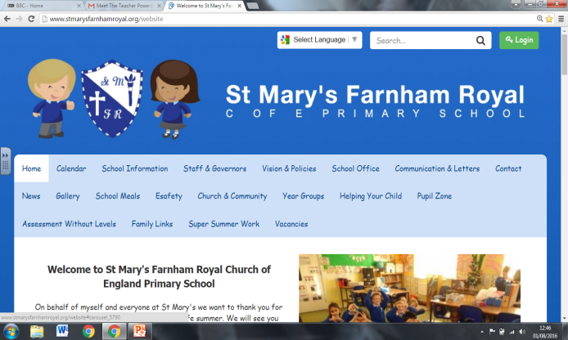
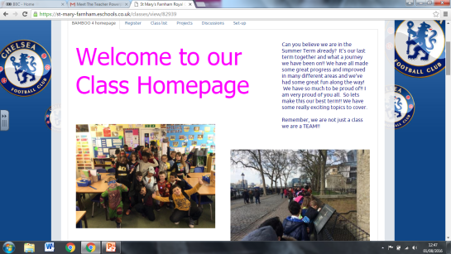
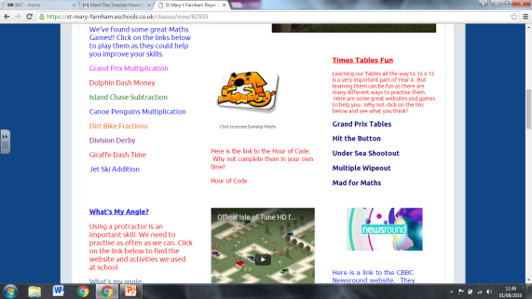
School Website and Class Webpage
Our School website is the place to access up to date information about all things happening at school.
On our school website, you will find lots of useful information and links to help support all the learning
that happens at school.
stmarysfarnhamroyal.org
Each class has their own secure Webpage created and updated by the class teachers. This is accessed by an individual login.
Children are encouraged to use targeted activities and links identified by teachers to support the learning in class.
St Mary’s Farnham Royal Church of England Primary School
‘is a GOOD school’ – Ofsted November 2015

Slide 16
Arrival and Home times
Parents from all year groups should make sure the office have an up-to-date list of who has permission to collect their child
School gates now open at 8:30am and registration is at 8:45am (school gates also close 8:45am)
Children must be collected from the teacher by an agreed person
Year 5 & 6 are the only children able to leave the school site alone at home time
This is only with written permission from you
St Mary’s Farnham Royal Church of England Primary School
‘is a GOOD school’ – Ofsted November 2015

Slide 17
Communication
Daily messages
Teachers at home time
School Office Tel: 01753644471
Office@stmarysfarnhamroyal.org
Whilst there are members of SMT on the gate each morning there priority is the safe entry of the children and they may not be able to speak at length
Staff by appointment via the school office
Website – up to date calendar
ESchools APP
School sends info, reminders & notices
Log in via eschools
If you do not have the APP then emails will be sent to your email address
Paper Letters
Only if permission is required
Facebook
Follow: St Mary's Farnham Royal Primary School
(Not all message's go onto this public forum)
St Mary’s Farnham Royal Church of England Primary School
‘is a GOOD school’ – Ofsted November 2015

Slide 18
Any Questions?
Presentations will be made available on the school website
wwww.stmarysfarnnhamroyal.org
Important school dates for the year ahead are available
St Mary’s Farnham Royal Church of England Primary School
‘is a GOOD school’ – Ofsted November 2015

