Slide 1
Welcome to the EYFS
at
St Mary’s Farnham Royal
Through FAITH, as a FAMILY we aspire to grow. Thriving for all our FUTURES, enabling us to FLOURISH individually and as a community.
Your child’s AMAZING learning journey of discovery starts right here…
St Mary’s Farnham Royal Church of England Primary School
‘is a GOOD school’ – Ofsted November 2019

Slide 2
Welcome to the EYFS: Nursery & Reception
NURSERY Team:
Nursery Reception Teachers:
Mrs Connolly (4 days)
Mrs Birch (Wednesday)
Early Years Practitioners:
Miss Honeywell
Mrs Moore (lunchtimes and 2 afternoons)
St Mary’s Farnham Royal Church of England Primary School
‘is a GOOD school’ – Ofsted November 2015

Slide 3
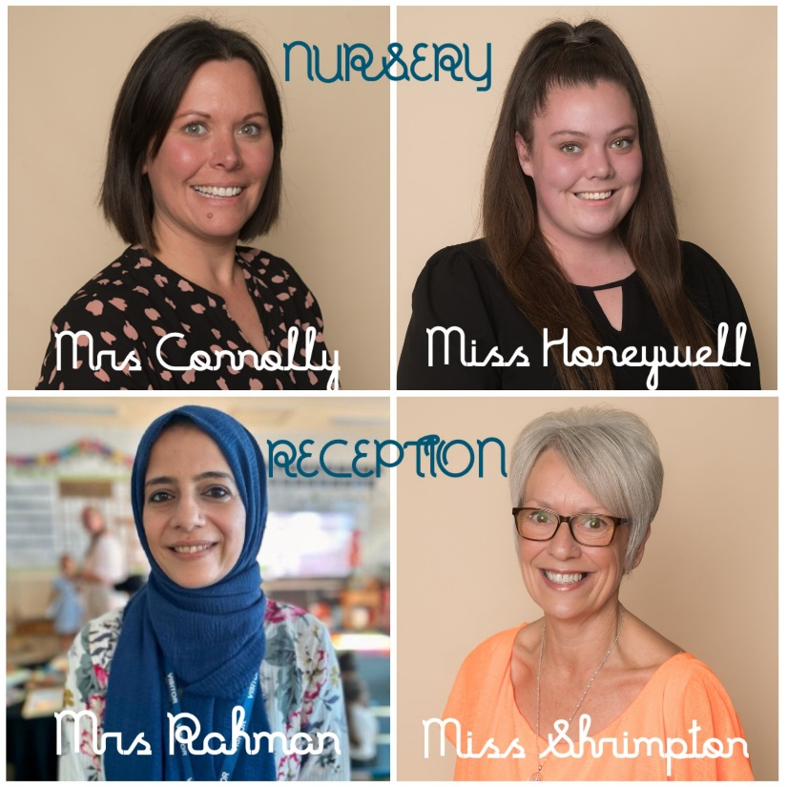

RECEPTION Team:
Class Teachers: Mrs Rahman
Early Years Practitioner: Miss Shrimpton
Assistant Head (EYFS & KS1): Miss Bachmann

Slide 4
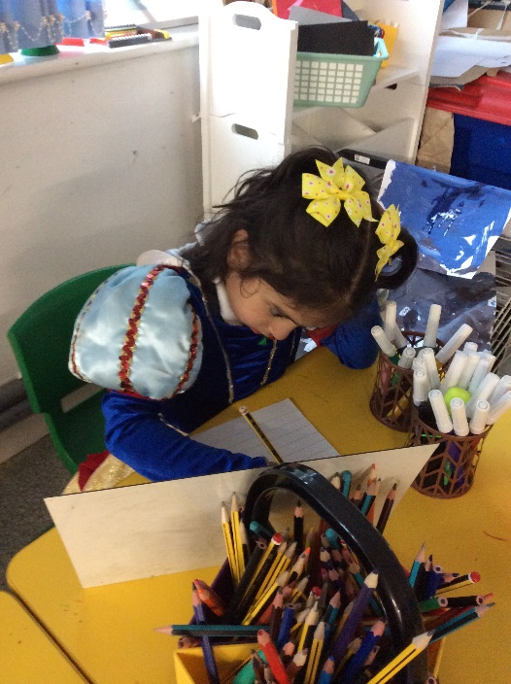
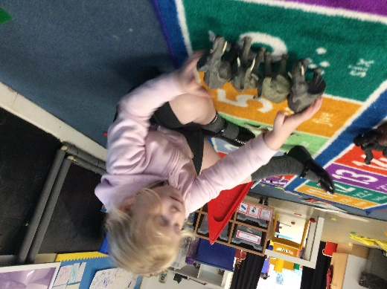
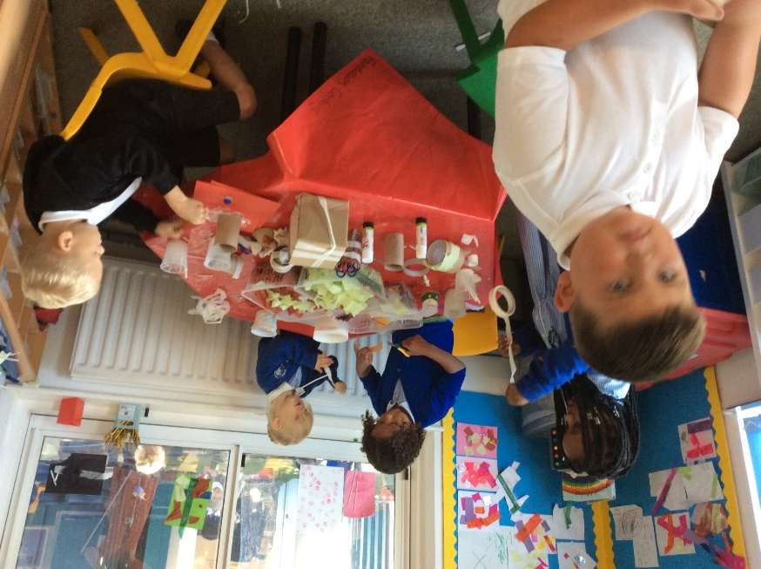
What is the Early Years Foundation Stage?
The Early Years Foundation Stage (E.Y.F.S.) is the stage of education for children from birth to the end of the Reception year.
It is based on the recognition that children learn best through play and active learning.

Slide 5
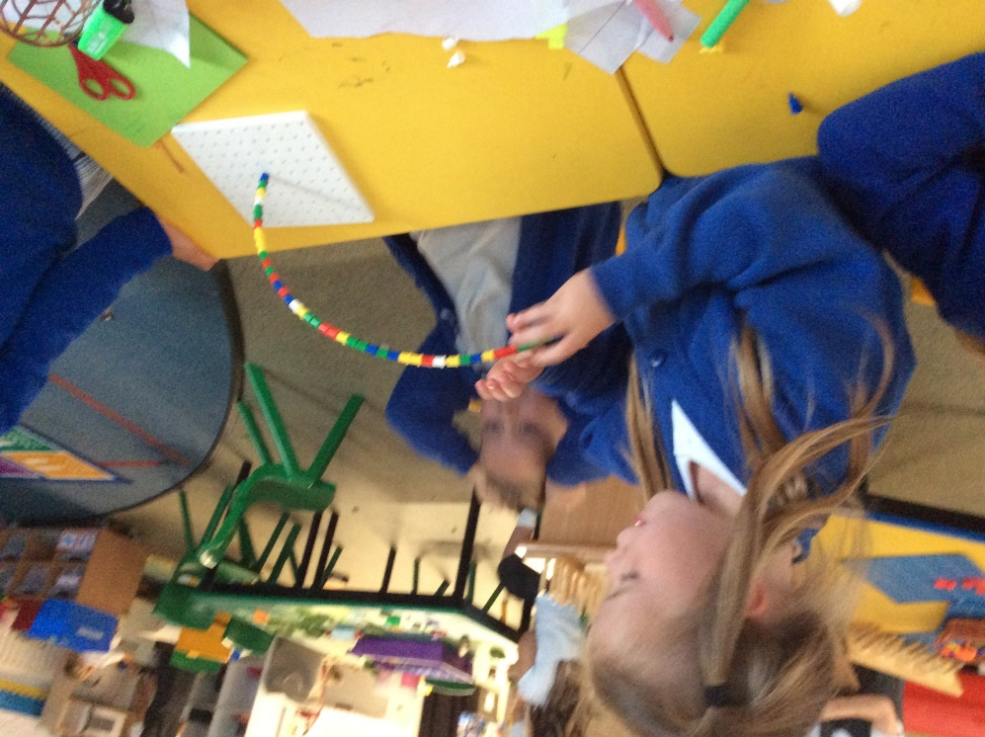
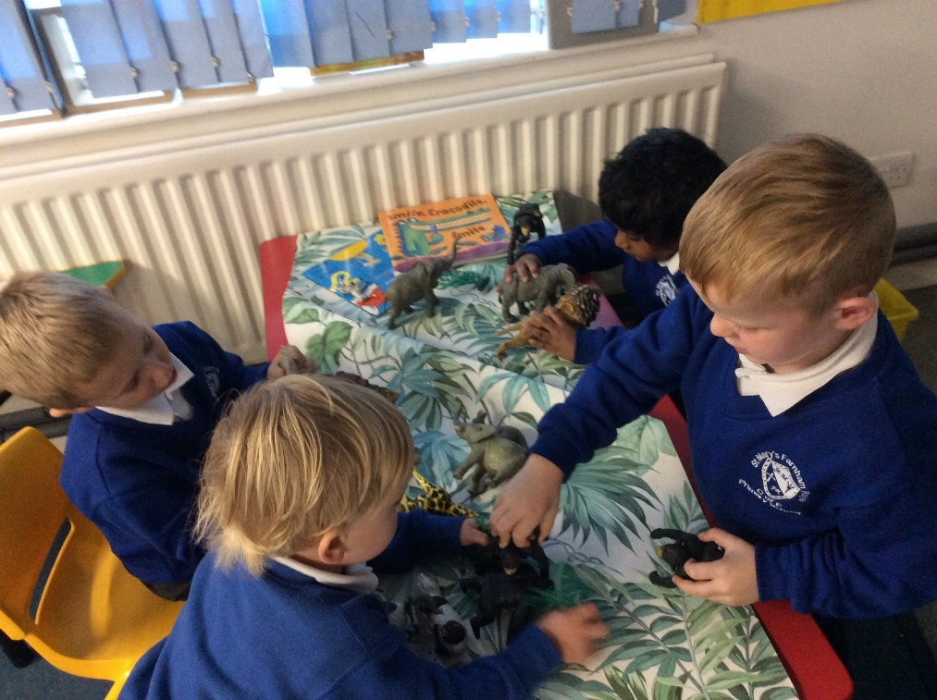
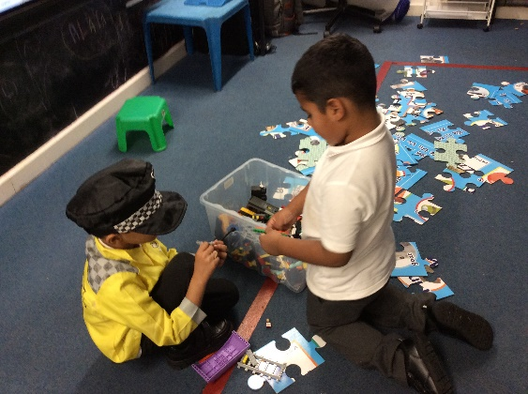
Communication & Language
Communicating with one another and developing skills in speaking, listening, reading and writing.

Slide 6
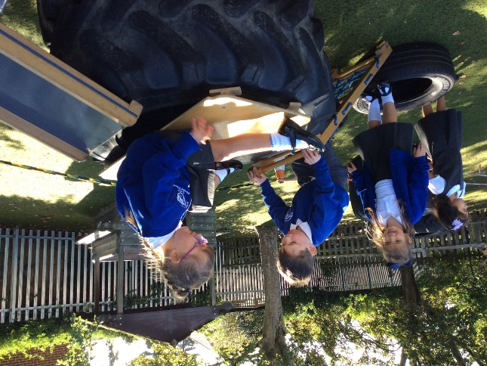
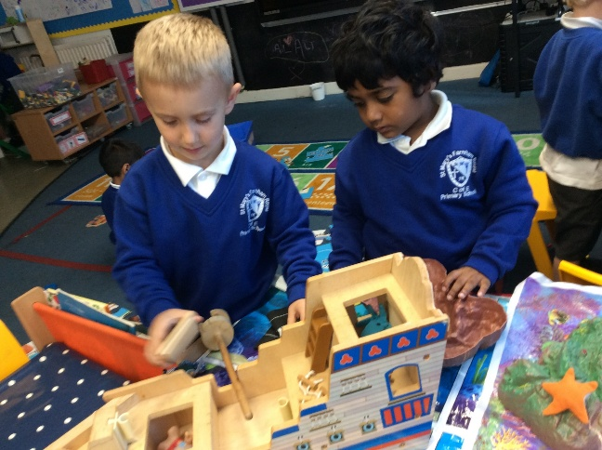
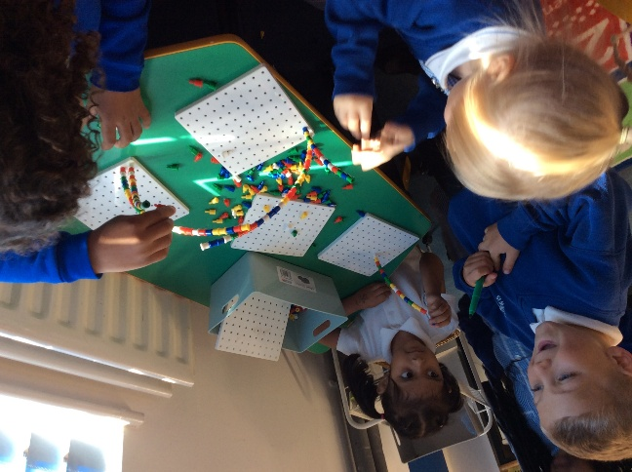
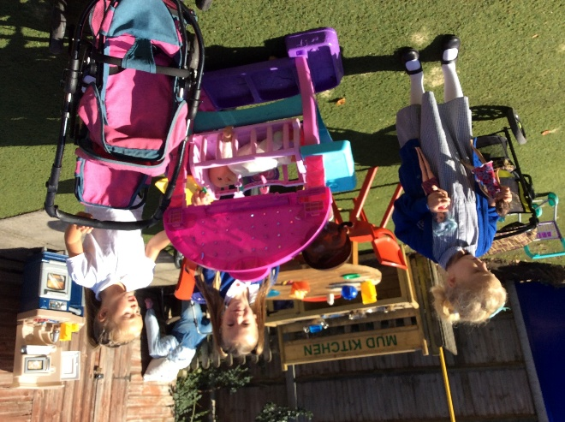
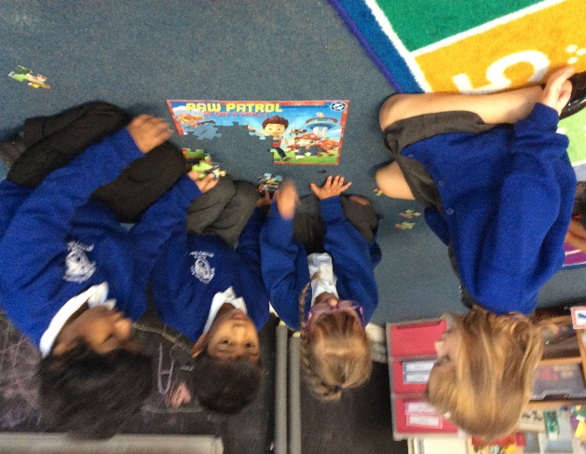
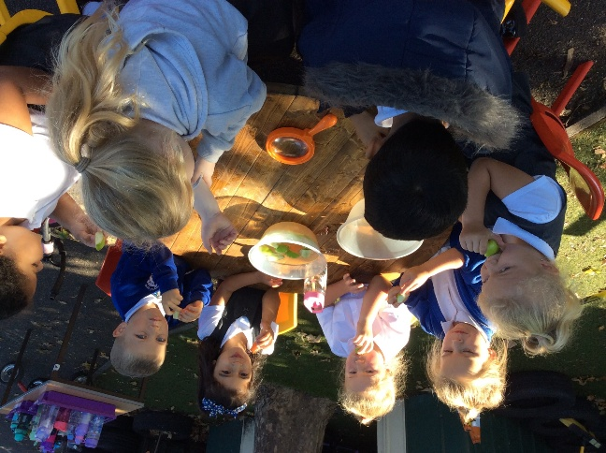
Opportunities to talk & talk & TALK!

Slide 7
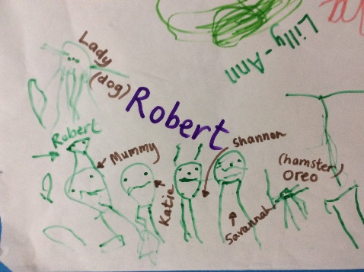
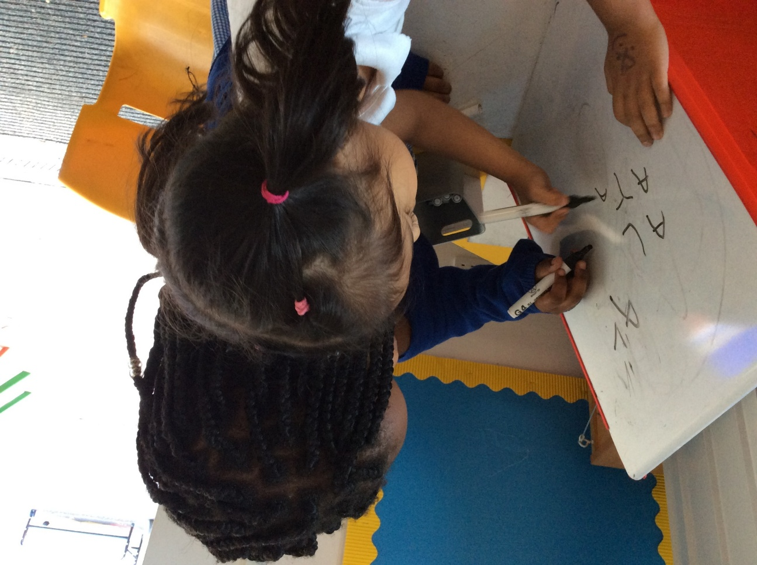
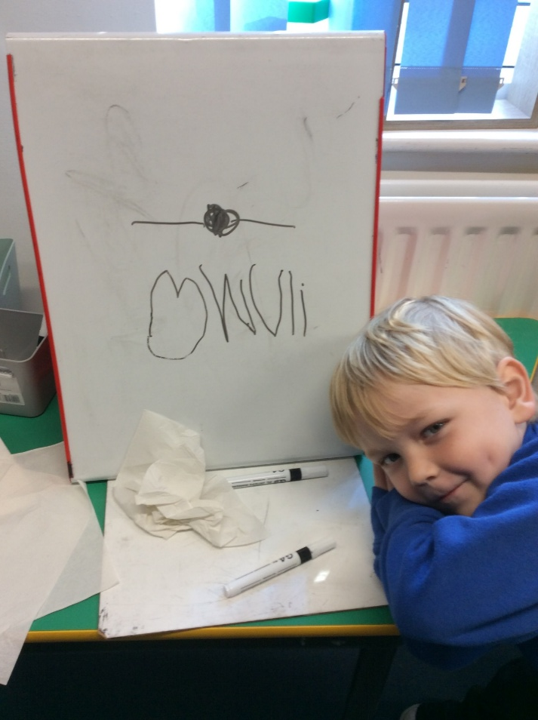
Talk leads to writing – but let them write for a REASON!

Slide 8
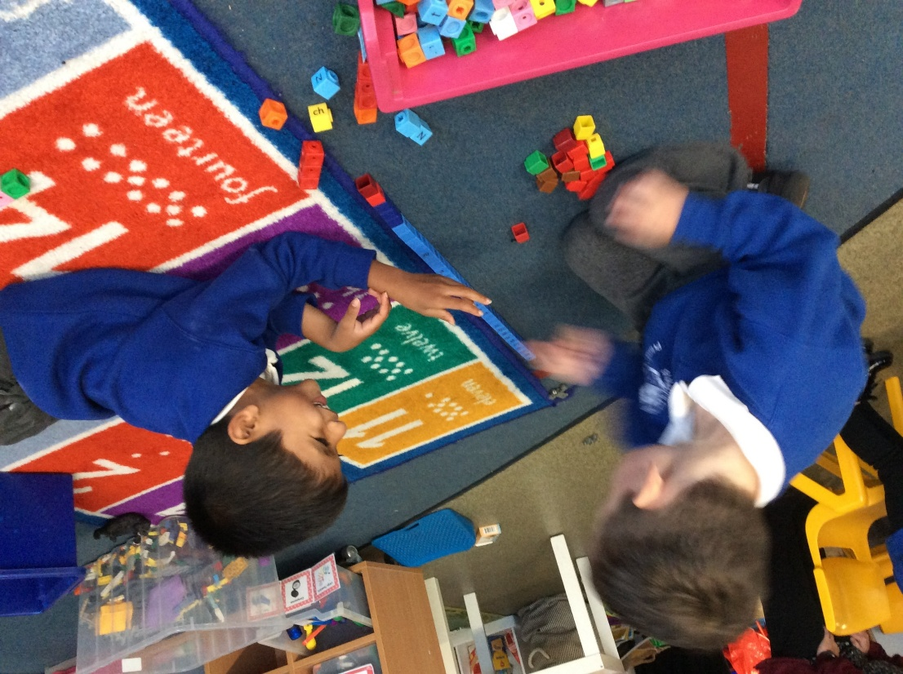
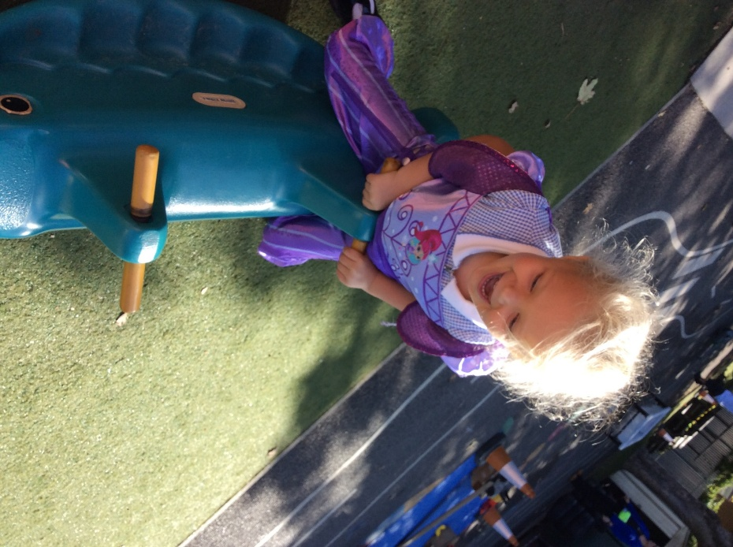
Personal, Social & Emotional Development
Developing confidence and independence while learning to concentrate and enjoy sharing as part of a group.

Slide 9
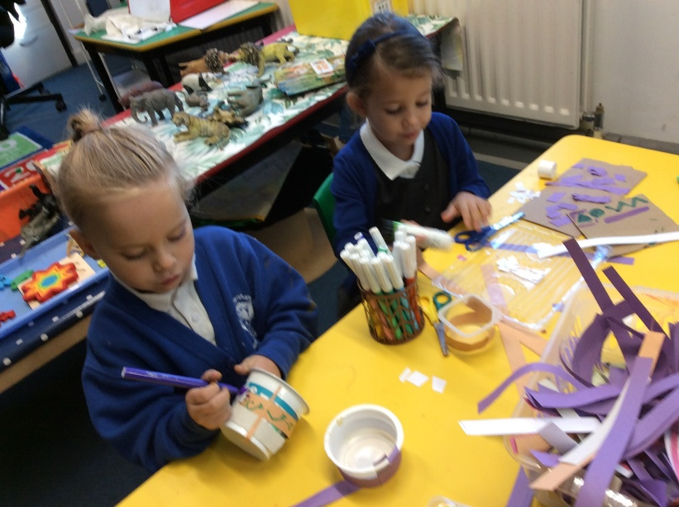
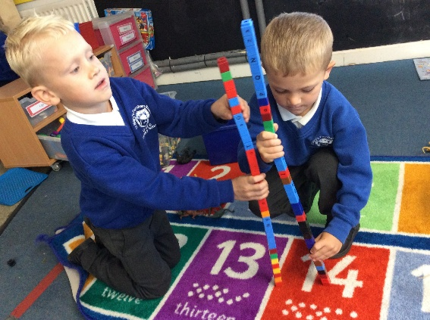

Physical Development
Learning through physical movement is a VITAL component of the EYFS – recent research is highlighting this as key to high quality learning
Developing and practising their fine motor and gross motor skills, increasing their understanding of how their bodies work and what they need to do to be healthy and safe.
Fine Motor Skills – pencil grip, scissor control, safe use
of tools, etc.
Gross Motor Skills – apparatus, small equipment, etc.

Slide 10

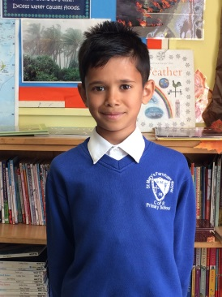
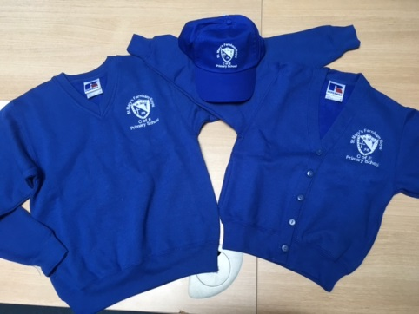
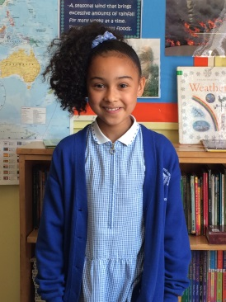
SMFR Children dressed & ready for school!
We are very proud of our school. Our uniform expectations reflect this and they encourage children to take pride in themselves, their school and the work they produce.
Girls:
• white blouse or polo shirt
• grey skirt, pinafore dress or trousers
• blue v-neck sweat shirt with school logo, or
cardigan with the school logo
• silver and royal blue striped tie
• grey or white socks or tights
• black flat heeled school shoes (preferably
with velcro) — no trainers or boots
•in summer, a blue and white striped
or gingham dress
Boys:
• white shirt or polo shirt
• grey shorts or trousers
• blue v-neck sweat shirt with
school logo
• silver and royal blue striped tie
• grey or white socks
• black school shoes (preferably
with velcro) — no trainers or boots
Please label EVERYTHING clearly!
St Mary’s Farnham Royal Church of England Primary School
‘is a GOOD school’ – Ofsted November 2015

Slide 11
Key points in our School Day
We ask parents to be punctual at drop off and collection.
8:30 am Drop off - 8:45 am School day begins
8.45 am Register, welcome and Early Morning Activity
9.00 am FFT Phonics session
9.30 am Free flow Learning – time to get busy!
10.00 – 10.30 am Reception Snack Shack Open Nursery Sharing Circle
11.30 am Nursery AM home time. Lunchtime Prayer/Story
11.45 – 12.15 Lunchtime in the hall (Nursery & Reception) 12.30 - PM Nursery arrive
1.00 – 1.30 pm Topic/Whole class learning
1.30 pm Free flow learning – time to get busy!
2.50 pm Quiet Reflection & Collective Worship/Story Time
3.15 pm Home Time Song and School Prayer
St Mary’s Farnham Royal Church of England Primary School
‘is a GOOD school’ – Ofsted November 2019

Slide 12

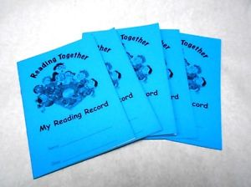

What your child needs to bring to school
Water bottle- with water only please, juice will be replaced with water as per our school policy
Waterproof coat and wellies (to keep in school)
Change of clothes (or two!) - to stay in school
Book bag – for their FFT and chosen picture book
Reading book and reading record
Their kind hands, kind, feet, kind words (SMFR EYFS expectations)
Their SMILE! ☺
Please ensure everything is clearly named to help your child and ensure items are returned to you.
St Mary’s Farnham Royal Church of England Primary School
‘is a GOOD school’ – Ofsted November 2019

Slide 13
Reception P.E.
P.E. falls under the EYFS PRIME AREA of Physical Development and a very important part of your child’s week in Reception.
P.E. incorporates numerous skills including gymnastics, dance, athletics and a range of different sports that develop fine and gross motor movements that support growth and early writing.
The children have one PE session every Thursday morning with our SMFR PE Teacher Mrs Daywan
THEY CAN COME DRESSED IN THEIR PE KIT TO WEAR ALL DAY…
Earrings will be taped if not removed – we would prefer for them to be removed before school.
St Mary’s Farnham Royal Church of England Primary School
‘is a GOOD school’ – Ofsted November 2015

Slide 14

PE Kit – To wear to school on PE Day
School PE Shirt
Black/Navy shorts
Trainers
Black/Navy jogging bottoms for colder weather
Royal blue v-neck sweatshirt, with or without school logo
No Jewellery – Micropore tape for newly studded earrings
Sweatbands to cover religious bangles if applicable
Hair
Hair styles should be appropriate for school
Shoulder length hair must be tied back
Hair accessories with flowers, large bows etc are not part of school uniform Jewellery
Jewellery must not be worn. However, if your child has newly pierced ears, small plain stud earrings may be worn. These will be taped over during PE.
We ask that, where possible, you remove these on Reception PE days.
Nail varnish should not be worn in school.
St Mary’s Farnham Royal Church of England Primary School
‘is a GOOD school’ – Ofsted November 2019

Slide 15
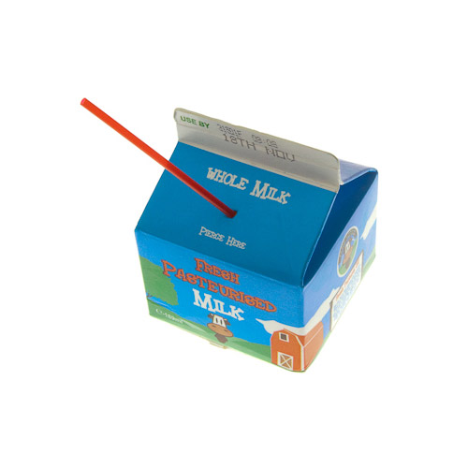

Fruit and Milk Time
Milk is free up to the age of 5 and can be ordered online via ‘Cool Milk’ – please ask the office about this.
Nursery children can bring a snack daily for their daily sharing circle snack time.
Reception children can choose from various fruits for their snack, that will be provided as part of The School Fruit & Vegetable Scheme (SFVS).
If your child would like to bring in preferred fruit (in a named pot) you are welcome to do so.
Please ensure the office are aware of any dietary requirements PRIOR to your child starting with us.
St Mary’s Farnham Royal Church of England Primary School
‘is a GOOD school’ – Ofsted November 2019

Slide 16
Hot Lunches
Children in Reception to Year 2 are entitled to a Universal Free school meal each day.
Menus change termly and are a three week rolling menu.
Each term, the website is updated with the new menu. Please choose carefully with your child, so they know what to expect and are happy with the choice.
Nursery children who join us for lunch are welcome to have a hot school dinner. Parents will be charged via their online account. Otherwise, they will need to bring a healthy packed lunch with them every day.
Please ensure the office and Class Teachers are aware of any dietary requirements – or CHANGES to these AS SOON as you are aware.
St Mary’s Farnham Royal Church of England Primary School
‘is a GOOD school’ – Ofsted November 2019

Slide 17
Packed Lunches
All Nursery and Reception children are welcome to bring a healthy packed lunch if they would prefer.
Packed Lunches should be healthy:
No foods containing nuts are allowed in school (including chocolate spread & peanut butter)
No chocolate, other than biscuit based chocolate snacks
No sweets or high sugar foods
All children should have a packed lunch drink as well as a water bottle.
There are some great healthy lunchbox ideas on https://www.nhs.uk/healthier-families/recipes/healthier-lunchboxes/
Please ensure the office and Class Teachers are aware of any dietary requirements – or CHANGES to these AS SOON as you are aware.
St Mary’s Farnham Royal Church of England Primary School
‘is a GOOD school’ – Ofsted November 2019

Slide 18
Our Curriculum
The Early Years Foundation Stage Framework is a statutory guidance that your child may have learnt from at their previous settings. Within the EYFS, we also use the Characteristics of Effective Teaching and Learning.
These are based on how each child learns and developed the skills they need to ensure a good attitude to learning throughout their school life.
The EYFS covers 3 prime areas:
Communication and Language
Personal Social and Emotional Development
Physical Development
and 4 specific areas:
Literacy
Mathematics
Understanding the World
Expressive Art and Design.
The Characteristics of Effective Learning are:
Playing and Exploring
Active Learning
Creating and thinking critically
St Mary’s Farnham Royal Church of England Primary School
‘is a GOOD school’ – Ofsted November 2019

Slide 19
Our Curriculum
We deliver The Cornerstones Curriculum from Nursery to Year 6. This is an in depth curriculum that ensures greater understanding of concepts and topics.
Cornerstones ensures parents are a key part in their child’s learning. You will be provided with an overview at the start of each term. We start this in Week 4, when we also start teaching Phonics. We give daily feedback and in addition, throughout the year, we have parents evenings and reports so you are aware of how your child is getting on. We believe in an open and transparent dialogue is KEY for best learning outcomes so our door is always open.
At the end of their Reception year, children will be assessed against the Early Learning Goals. The ELGs are set at the development of a typical five year old.
Children are given emerging or expected against each of the 17 areas within the prime and specific areas.
More information on the latest 2025 Early Years Foundation Stage Framework can be found at
https://www.gov.uk/government/publications/early-years-foundation-stage-framework--2
St Mary’s Farnham Royal Church of England Primary School
‘is a GOOD school’ – Ofsted November 2019

Slide 20
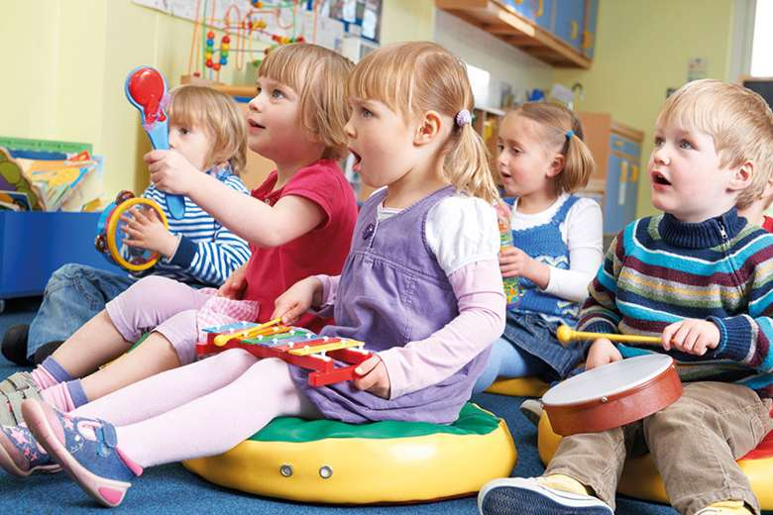
Your children will be making music every week with Mrs Gordon – our specialist Music Teacher!
Reception children have one Music session a week
Nursery & Reception are also exposed to singing rhymes, songs and access musical instruments in daily provision throughout the year…we LOVE a song to help us learn!

Slide 21

Tapestry
Tapestry is a secure, online learning portal used in our school to share WOW moments between school and home (and vice versa). We use this as an integral commination tool so that you can share the learning that your child is doing – this supports self-esteem, communication and language and your child’s recall of key learning we do. Every week you will see snapshots and we would urge you so snuggle together and let your child tell you all about it – we do this in school together too!
At the start of the year, you will receive a link to create a log in. Please follow the instructions on the link to create your account. From there you can see any observations we make of the children, upload your own ‘WOW’ moments, view notifications and upload home learning.
St Mary’s Farnham Royal Church of England Primary School
‘is a GOOD school’ – Ofsted November 2019

Slide 22
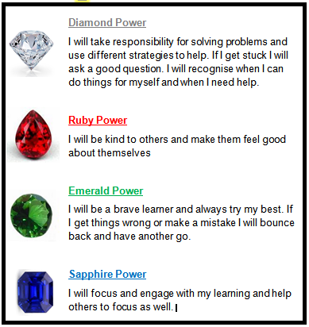
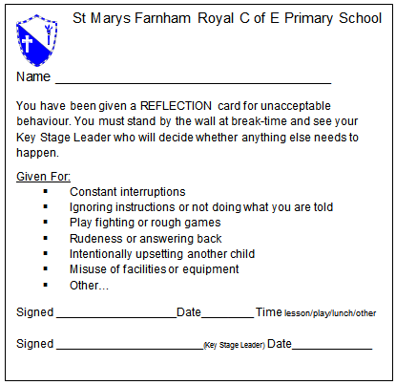
Behaviour System
Our whole school focus is VERY much on noticing the POSITIVE and rewarding this to promote positive outcomes. We believe this works BEST.
We use our Gem Project to reward positive behaviour and learning attitudes.
Children may receive Gem cards or receive a certificate when we join whole school assemblies in the 2nd half of the summer term.
St Mary’s Farnham Royal Church of England Primary School
‘is a GOOD school’ – Ofsted November 2015

Slide 23
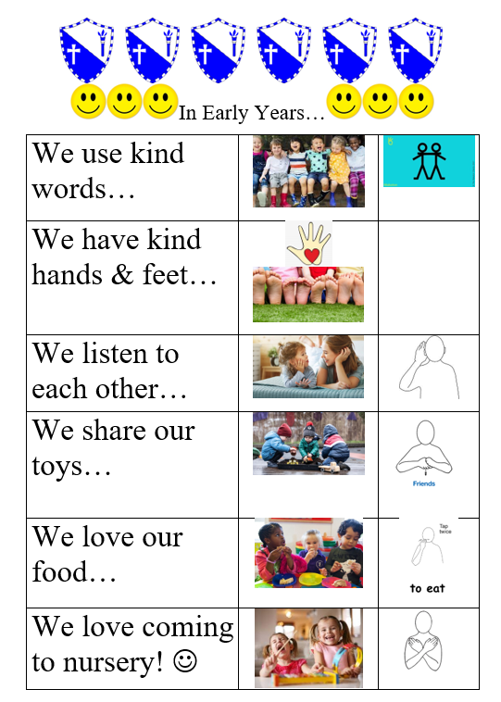
Our EYFS Rules:
We talk about our EYFS SMFR important rules every day…
St Mary’s Farnham Royal Church of England Primary School
‘is a GOOD school’ – Ofsted November 2019

Slide 24
How can you help? - Attendance
If your child regularly misses school they may develop gaps in their learning which can result in lower achievement & progress.
Your child should only miss school if:
They are too ill to attend – some useful information sheets are available.
You have advance permission from the school as it is an exceptional circumstance
We monitor the attendance for all children in our school. Nursery children’s attendance is also monitored as per the Parental Agreement and your Nursery child’s place may be withdrawn if attendance rules are not adhered to.
Please always call the school to let us know why your child is not attending.
St Mary’s Farnham Royal Church of England Primary School
‘is a GOOD school’ – Ofsted November 2019

Slide 25
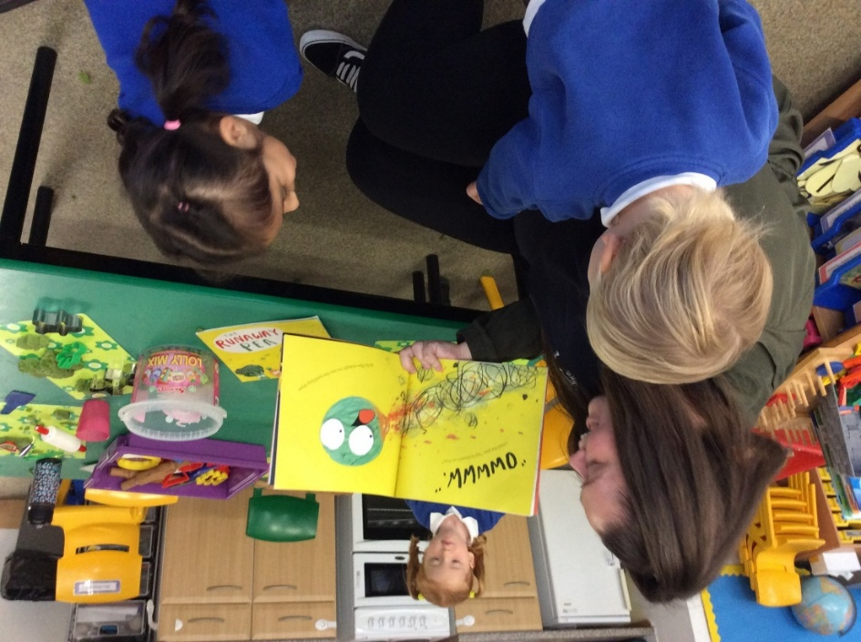
Read, read, READ!
Your child will need an SMFR school book bag:
We will change books every week on the day communicated by your child’s Class Teachers – Nursery choose a picture book for sharing, Reception bring their FFT Phonics book home to read at the end of each week too – so they can read to you!

Slide 26

The importance of Reading and Writing…
Pie Corbett
“It is crucial that children leave primary schools as confident readers and writers. One of our main tasks in primary schools has to be to secure sufficient competency, coupled with a love of reading and writing for this will open up their further education and pass on a lasting joy”.
If you as parents can do ONE thing in your very busy lives reading every day will TRULY make the BIGGEST difference to your child’s long term success.

Slide 27
Our promise to you…
To develop high self-esteem
To help your child be the very best that they can be
To develop independent thinking skills
To make your child feel 100% valued
To work in partnership with you
To make children autonomous in their learning
To make learning FUN
To celebrate strengths every single day
To develop their determination to keep trying!
To create an environment where they LOVE to learn! ☺

Slide 28
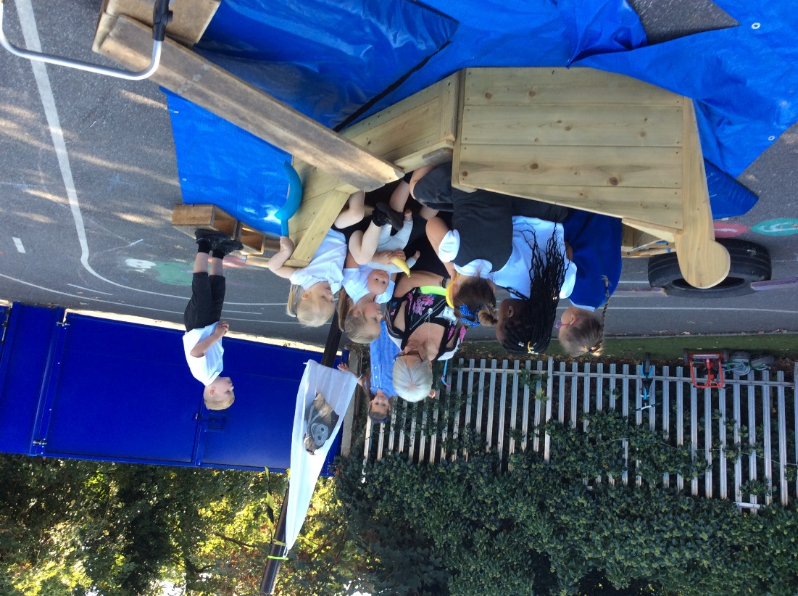
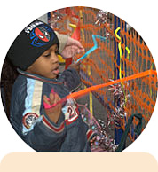
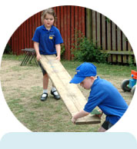
    “Adults who help children to play are adults who help children to learn.”

Slide 29

Communication
Daily messages
On the gate via a member of the SLT
Your Class Teacher at home time
School Office Tel: 01753644471
Email to Class Teacher vis: office@stmarysfarnhamroyal.org
Whilst there are two members of SLT on the gate each morning there priority is the safe entry of the children and they may not be able to speak at length.
Staff by appointment via the school office
Website – up to date calendar
Website Emails from all staff
School sends info, reminders & notices
Log in via eschools
If you do not have the APP then emails will be sent to your email address
Paper Letters
Only if permission is required
Facebook
Follow: St Mary's Farnham Royal Primary School
(Not all message's go onto this public forum)
St Mary’s Farnham Royal Church of England Primary School
‘is a GOOD school’ – Ofsted November 2015

Slide 30

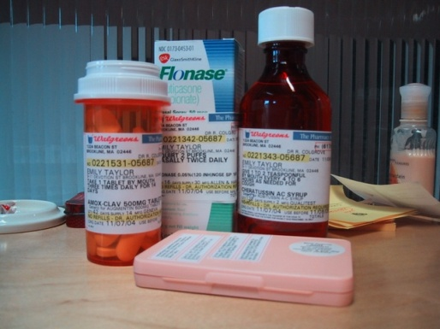

Important things to remember!
Please keep the school office up to date
with emergency
contact numbers
Only prescribed medicines
from doctor
Medication form TO BE FILLED IN AT THE FRONT OFFICE (PINK FORM)
Please ensure child collection list is up to date
St Mary’s Farnham Royal Church of England Primary School
‘is a GOOD school’ – Ofsted November 2019

Slide 31

Treetops Before and Afterschool Care
Breakfast Club is available from 7.30am - 8.30am
£5 for the hour, which includes breakfast.
Alternatively, your child can join us from 8.00am - 8.30am
£2.50. Breakfast not included.
After School Club runs from 3.30pm-5.30pm, 1.5hrs
£5 per hour, snack is included.
St Mary’s Farnham Royal Church of England Primary School
‘is a GOOD school’ – Ofsted November 2019

Slide 32
Pupil Premium Funding
Your child may be entitled to Pupil Premium Funding which will support their education. Applications are completely confidential.
How do I know if I am eligible?
Please fill out a form if you are experiencing any difficulties financially as you may be eligible.
The funding can help with trips, clubs, uniform and interventions in school.
Funding stays with your child until they leave primary school.
St Mary’s Farnham Royal Church of England Primary School
‘is a GOOD school’ – Ofsted November 2019

Slide 33
Pastoral Support
Our Senior Leadership Team (SLT) are here to help you with any issues that arise and are present daily on the school gates should you need to share any concerns you have at home and at school. We celebrate our Open Door Policy and welcome your face to face communication.
You may also be contacted by our SLT with regard to:
Safeguarding
Homework
Behaviour
Attendance
Reducing barriers to learning
Your Child's Well Being
St Mary’s Farnham Royal Church of England Primary School
‘is a GOOD school’ – Ofsted November 2019

Slide 34
Any Questions?
Please feel free to contact the school office who will pass on your message to your child’s Class Teacher – or relevant member of our SMFR team.
office@smfr.co.uk
THANK YOU for joining us on this incredibly magical learning journey!
☺
St Mary’s Farnham Royal Church of England Primary School
‘is a GOOD school’ – Ofsted November 2019

