Slide 1
Disclaimer/s
We hope you find the information on our website and resources useful.
Animations
This resource has been designed with animations to make it as fun and engaging as possible. To view the content in the correct formatting, please view the PowerPoint in ‘slide show mode’. This takes you from desktop to presentation mode. If you view the slides out of ‘slide show mode’, you may find that some of the text and images overlap each other and/or are difficult to read.
To enter slide show mode, go to the slide show menu tab and select either from beginning or from current slide.
You may wish to delete this slide before beginning the presentation.

Slide 3
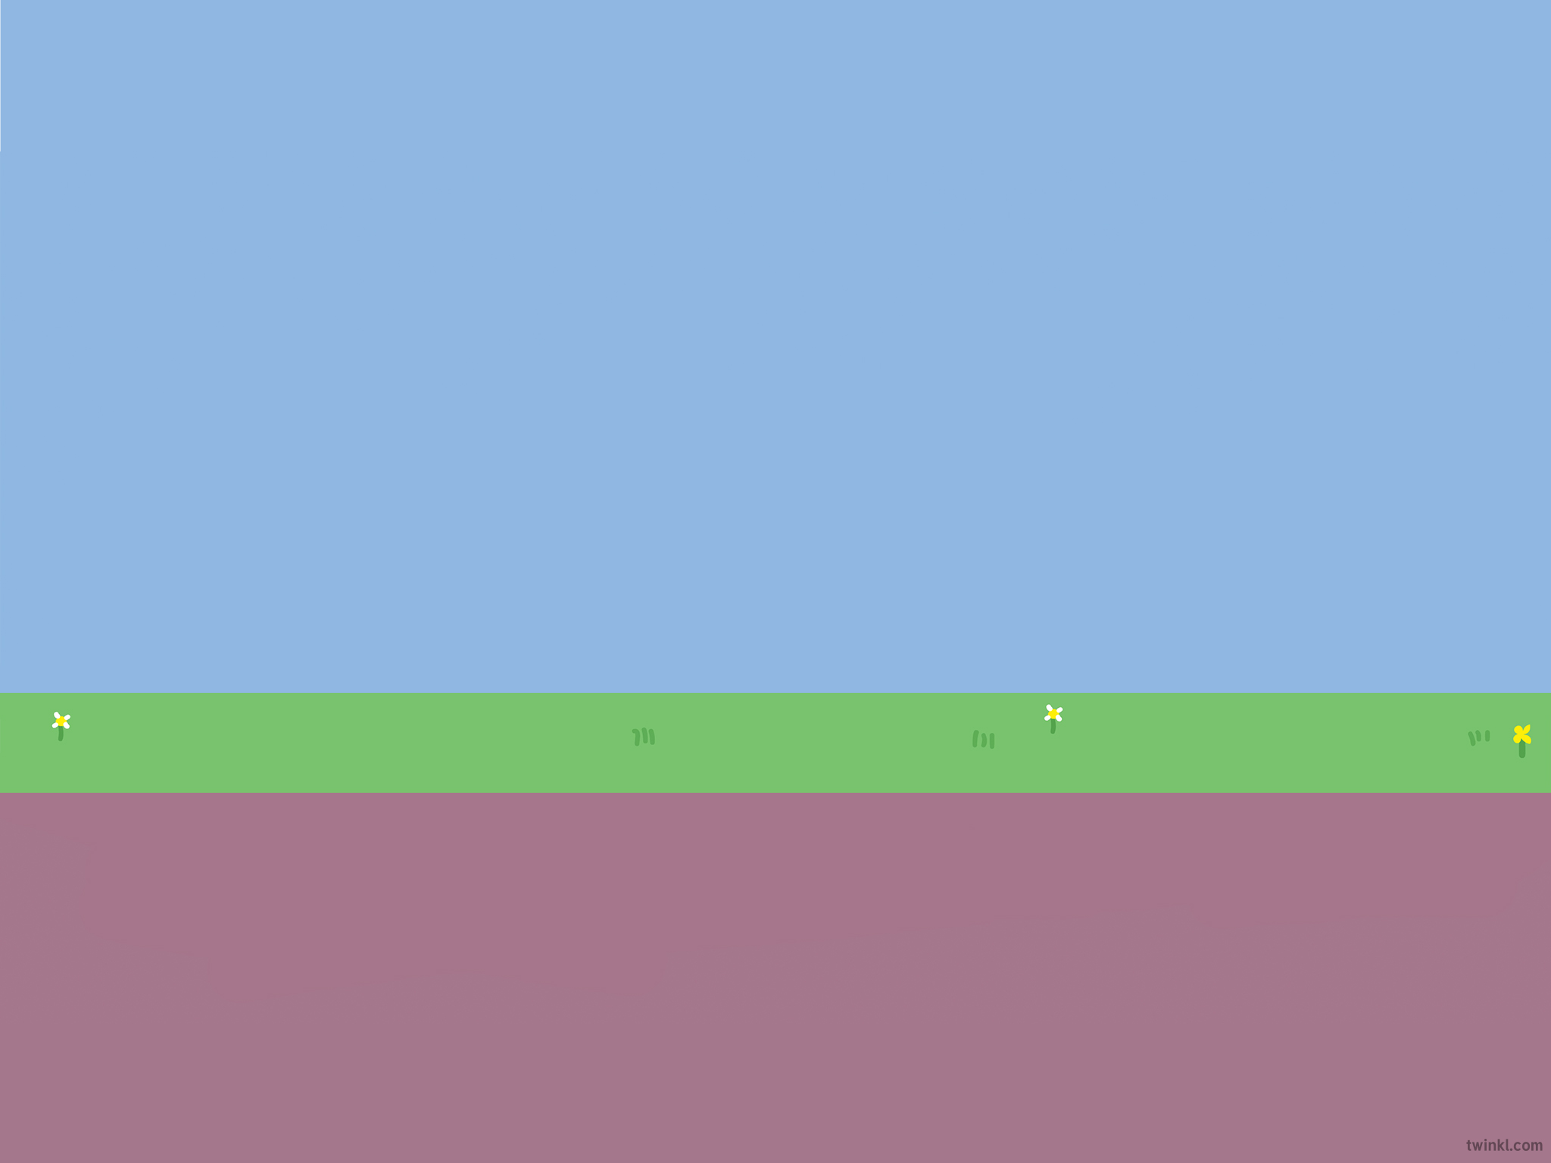

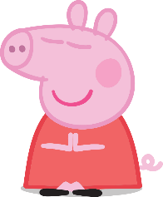
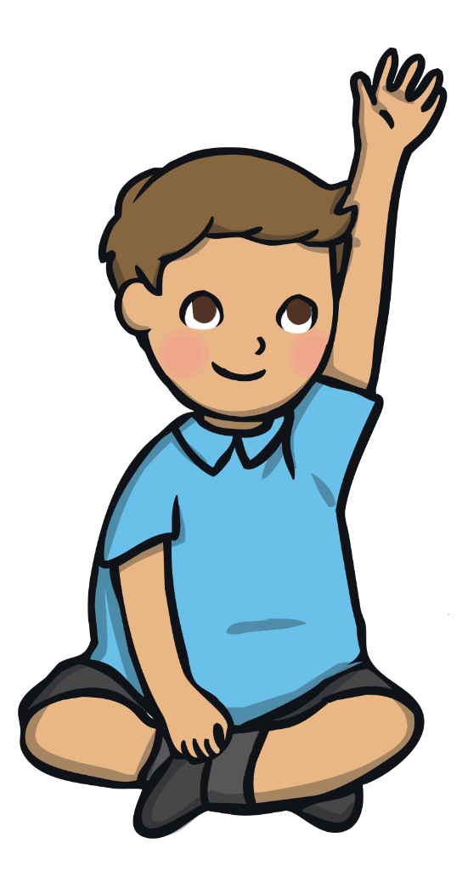

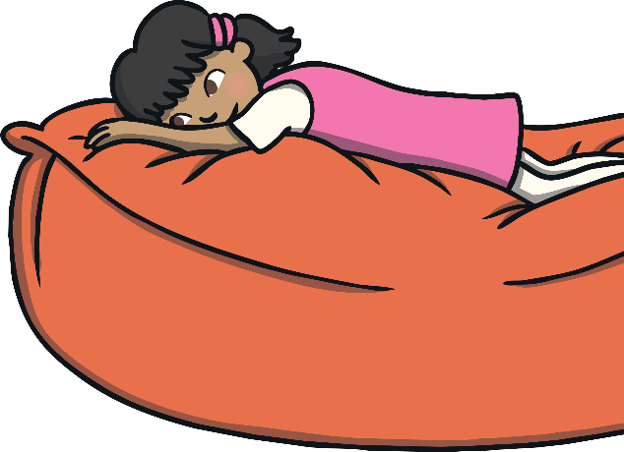

Putting all of your attention into the present moment
Slowing down and concentrating on one task or thing at a time
Focusing on something in a relaxed way

Slide 4

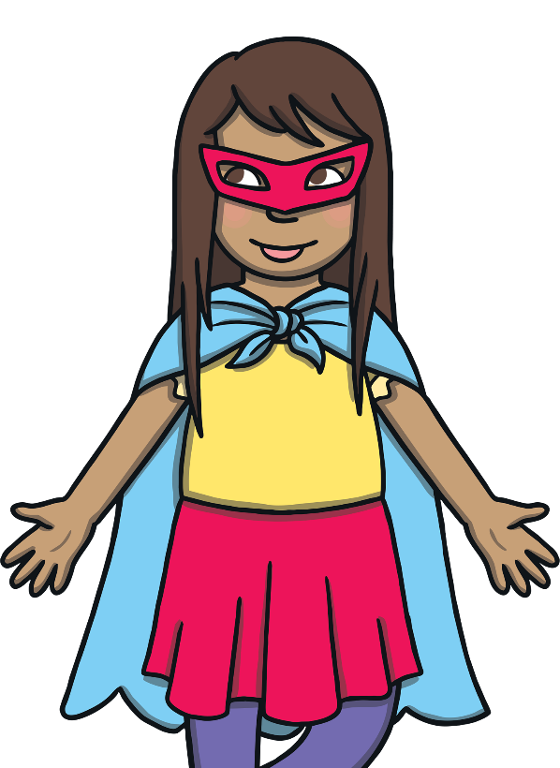
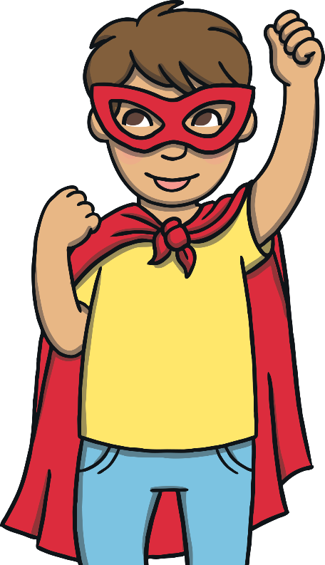
Being mindful helps you to:
Be less distracted
Stay calm when you are
upset, stressed or anxious
Listen to others better
Be more patient
Feel happier and more relaxed
Being mindful is
a superpower!

Slide 5

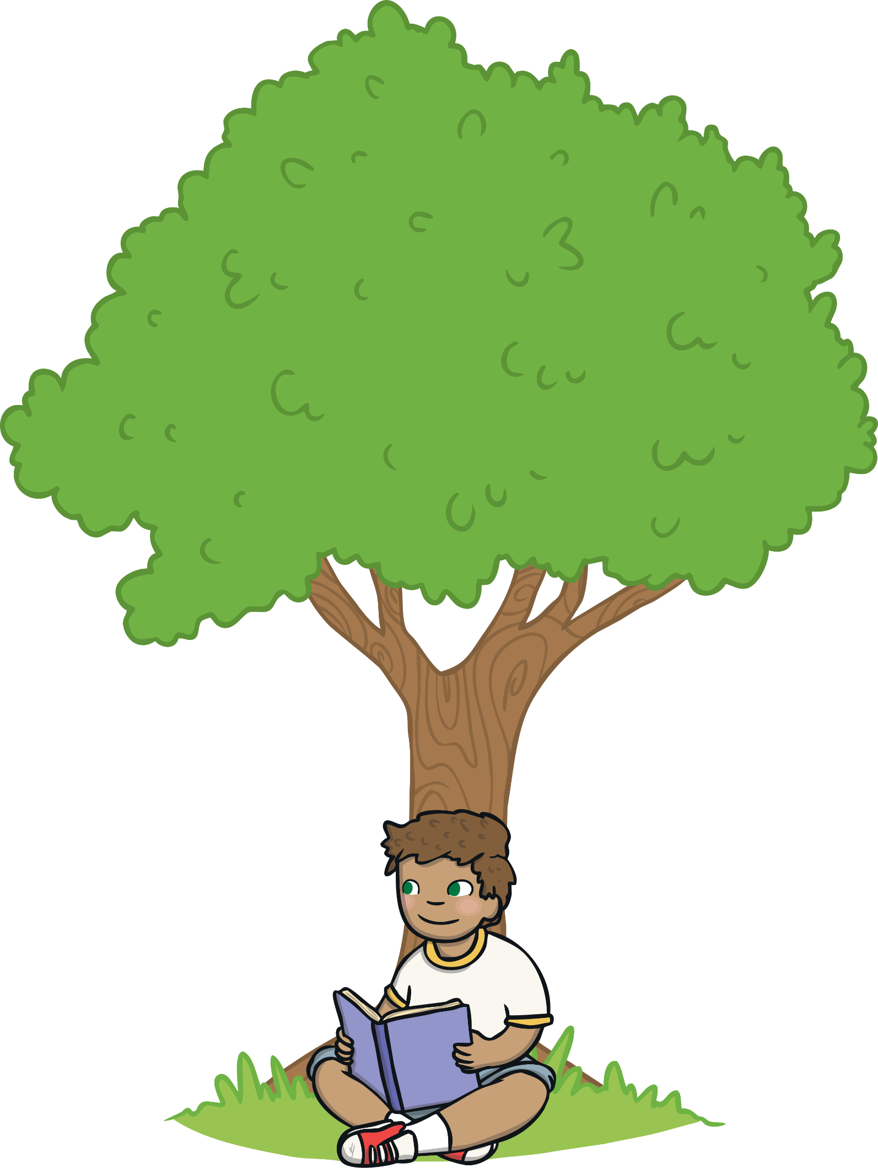

Mindful drawing
Getting into nature
Blowing bubbles
Reading quietly
Meditation
Listening to music
Gardening
Going for a walk
Some ideas are:
Being mindful or doing something mindful is personal.
What is mindful to you, may not be
to someone else!

Slide 6

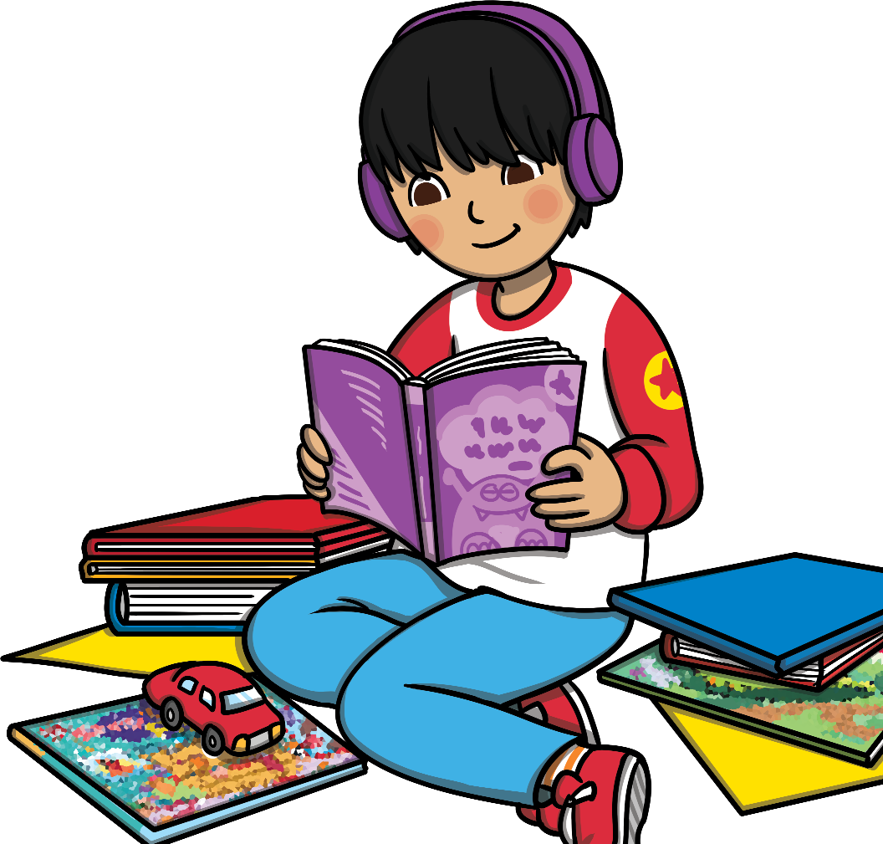

Mindfulness is personal. It is something that can be done by yourself in a quiet and calm way. You can make improvements to your ability to be more mindful by practising and trying hard to relax and engage in the present moment without being distracted.
Being mindful helps you to manage things that can
make you upset, angry, stressed, anxious and feel
more calm, happy and at peace.

Slide 7


Children have rights that are unique to them. A right is something that everyone is entitled to no matter where they live, how old they are, what culture they belong to or what gender they are.
You have a right to play and rest in a way that is best for you!

Slide 8
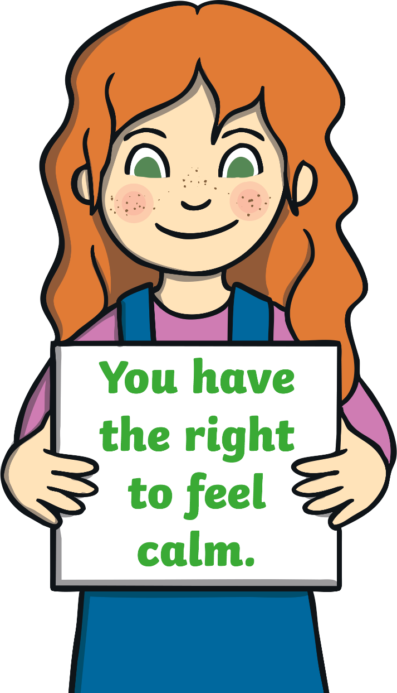
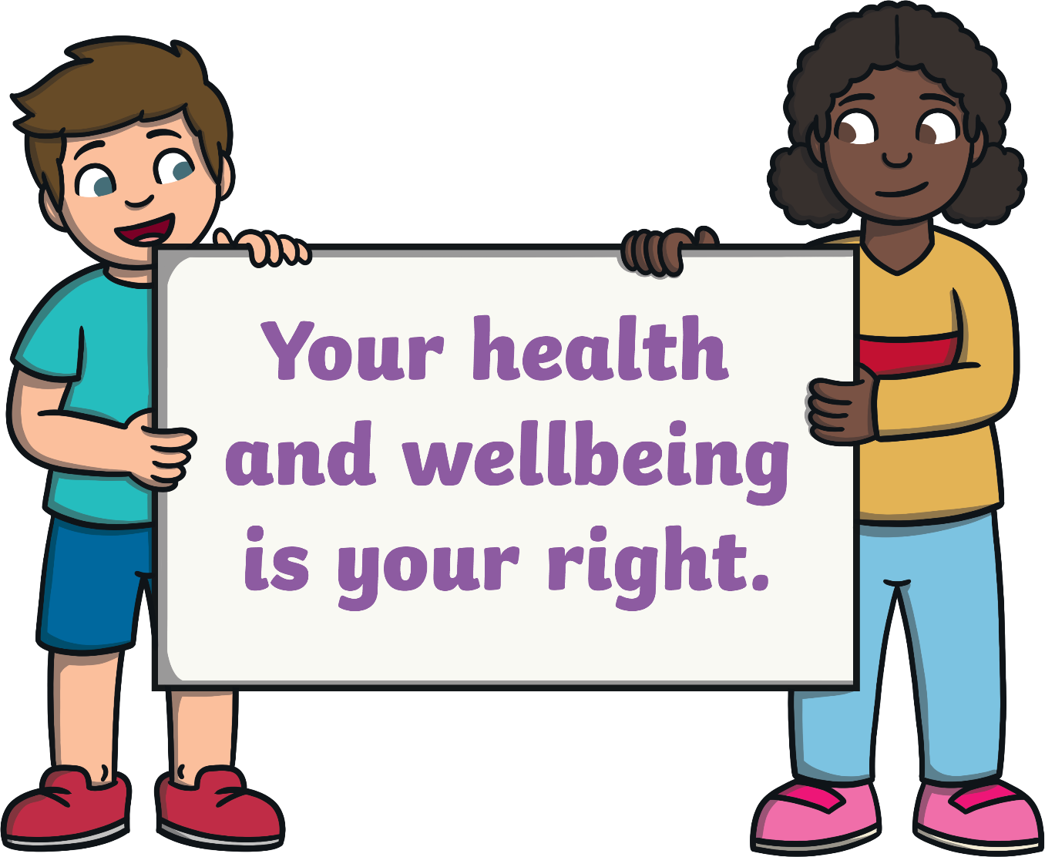

Slide 9
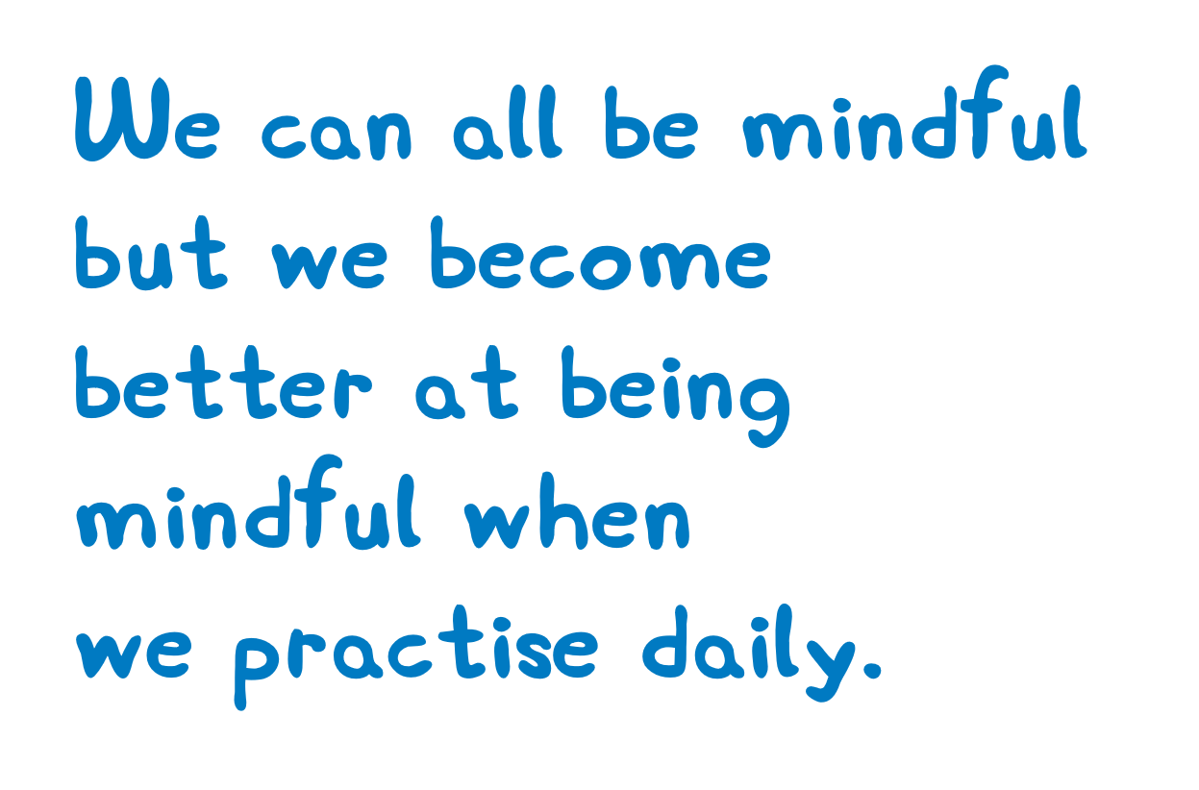
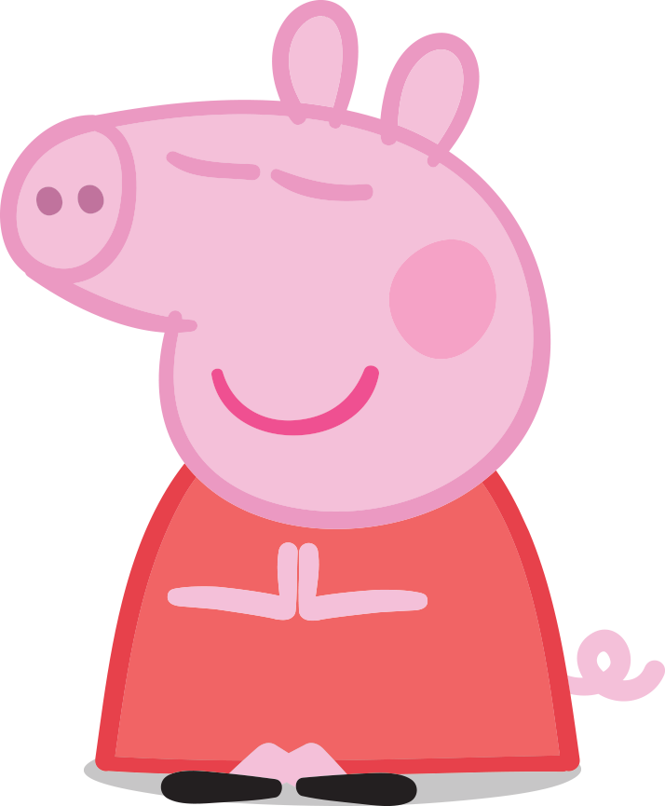

Slide 10

Choose something that you think will help you be mindful.
Practise it every day.
If one thing doesn’t help you feel mindful, try something else! What works for your friend, may not help you feel mindful!

